Slide 1

(BITCOIN)
KONKAN GYANPEETH COLLEGE OF ENGINEERING, KARJAT Affiliated to University of Mumbai, Approved by AICTE,
New Delhi.
Crypto-Currency
Price
Prediction

Slide 2
Project Members :
Shivprakash Vishwakarma(57)
Swaraj Kondlekar(32)
Afzal Ali Siddique(48)
Under the Guidance of
Prof. A.S Kunte

Slide 3
Contents
Abstract
Introduction
Objectives
Purpose
Scope
Implementation
Conclusion
Future Scope
References

Slide 4
ABSTRACT
The decentralization of cryptocurrencies has greatly reduced the level of central control over them, impacting international relations and trade. Further, wide fluctuations in crypto Currency price indicate an urgent need for an accurate way to forecast this price.
This project proposes a method to predict crypto Currency price by considering various factors such as market cap, volume, circulating supply, and maximum supply based on deep learning techniques such as the long short term memory (LSTM),which are effective learning models for training data, with the LSTM being better at recognizing longer-term associations.

Slide 5
INTRODUCTION
Crypto Currency, is a decentralized digital or virtual Currency. Use of cryptography for security makes it difficult to counterfeit. Cryptocurrencies started to gain attention in 2013 and since then witnessed a significant number of transactions and hence price fluctuations.
The crypto Currency market is just similar to Crypto-Currency market. It has gained public attention and so effective prediction of price movement of crypto Currency will aid public to invest profitably in the system.
This project tries to predict the price of Cryptocurrencies like Bitcoin. Deep learning techniques were implemented and the use of Long Short Term Memory (LSTM) network proved very efficient in predicting the prices of digital currencies.

Slide 6
Objectives
To implement LSTM model which will be train on available historical data.
To forecast the price of Crypto Currency(Bitcoin).
To integrate this model in order to develop simple system through which user can interact and perform predictions as per his requirements i.e no. of days for which he/she want to predict the future price of bitcoin.

Slide 7
Purpose
The Cryptocurrencies like Bitcoin are influenced by many uncertainties factor such as
Political issue
The economic issue at impacted to local or global levels
For the market, we can analyze with any techniques such as technical indicator, price movements, and market technical analysis.
To solve the problem regarding the fluctuations there’s a need automation tool for prediction to help investors decide for bitcoin or other crypto Currency market investment.
Nowadays the automation tools are usually used in common Crypto Currency market predictions, and we can do the same works and strategy on this domain cryptocurrencies.
The purpose of this study is to predict the price of Bitcoin and changes therein using the LSTM model and to build a system which will help common people, investors or business analyst to invest in digital currencies as bitcoin by predicting their future values and to visualize and analyse the pattern of digital currencies

Slide 8
Scope
We are visualising historical bitcoin data.
The Missing values in the dataset is handled by using Imputation Technique i.e Interpolation which imputes the missing values in time-series.
Exploratory data analysis is done by visualising using lag plots & further time resampling i.e aggregate data into a defined time period, such as by month or by quarter.
Model Selection and Model Building.
Prediction using LSTMs

Slide 9
Implementation
Dataset Includes Historical bitcoin market data at 1-min intervals for select bitcoin exchanges where trading takes place. It consists time period of Jan 2012 to September 2020, with minute to minute updates of OHLC (Open, High, Low, Close), Volume in BTC and indicated Currency, and weighted bitcoin price.
The Open and Close columns indicate the opening and closing price on a particular day.
The High and Low columns provide the highest and the lowest price on a particular day, respectively.
The Volume column tells us the total volume of traded on a particular day.
The Weighted price is a trading benchmark used by traders that gives the weighted price a security has traded at throughout the day, based on both volume and price. It is important because it provides traders with insight into both the trend and value of a security.

Slide 10
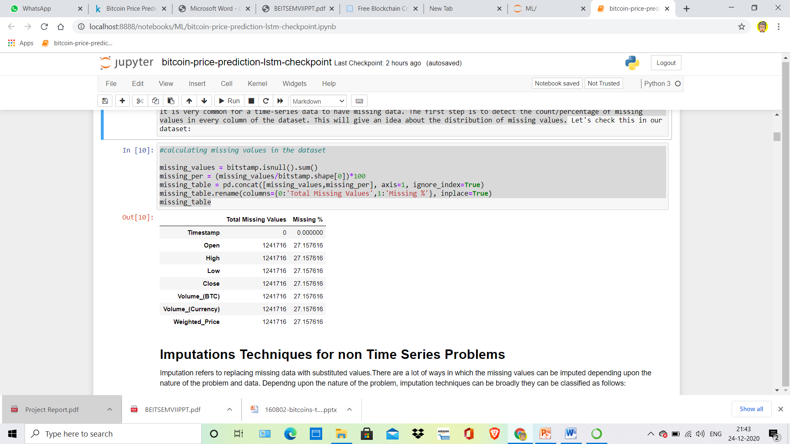
Handling Missing Values in Time-series Data
It is very common for a time-series data to have missing data. The first step is to detect the count/percentage of missing values in every column of the dataset. This will give an idea about the distribution of missing values.

Slide 11
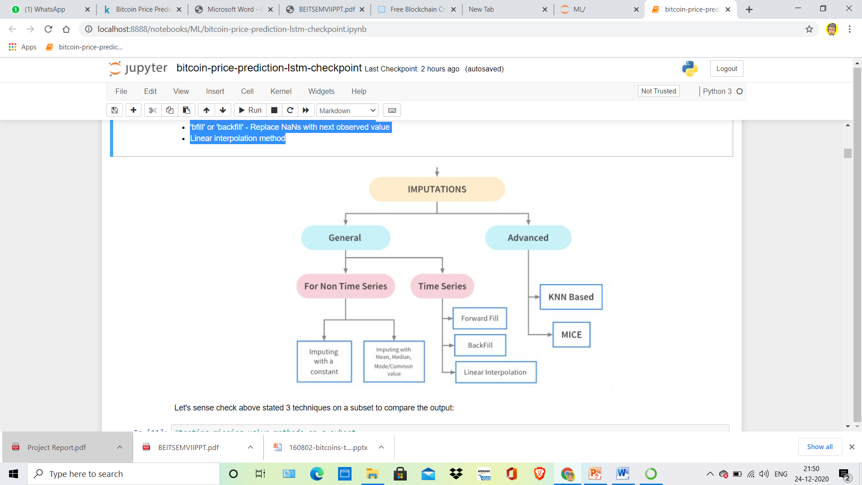
Imputation refers to replacing missing data with substituted values.There are a lot of ways in which the missing values can be imputed depending upon the nature of the problem and data. Depending upon the nature of the problem, imputation techniques can be broadly they can be classified as follows:
Basic Imputation Techniques for Time-Series data
'ffill' or 'pad'
– Replace NaNs with last observed value
'bfill' or 'backfill'
– Replace NaNs with next observed value
Linear interpolation method

Slide 12
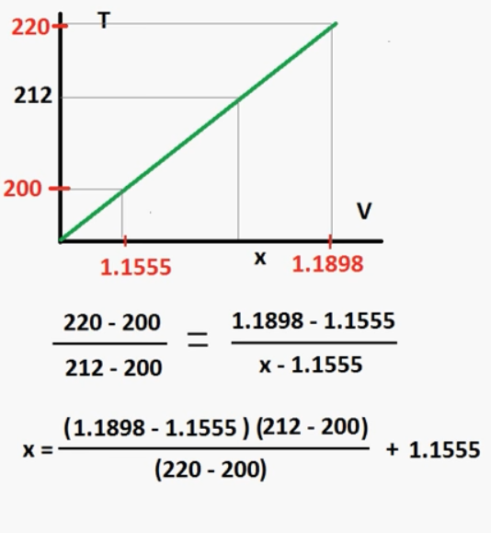
Imputation using Linear Interpolation method
Time series data has a lot of variations against time. Hence, imputing using backfill and forward fill isn't the best possible solution to address the missing value problem. A more apt alternative would be to use interpolation methods, where the values are filled with incrementing or decrementing values.
Linear interpolation is an imputation technique that assumes a linear relationship between data points and utilises non-missing values from adjacent data points to compute a value for a missing data point.

Slide 13
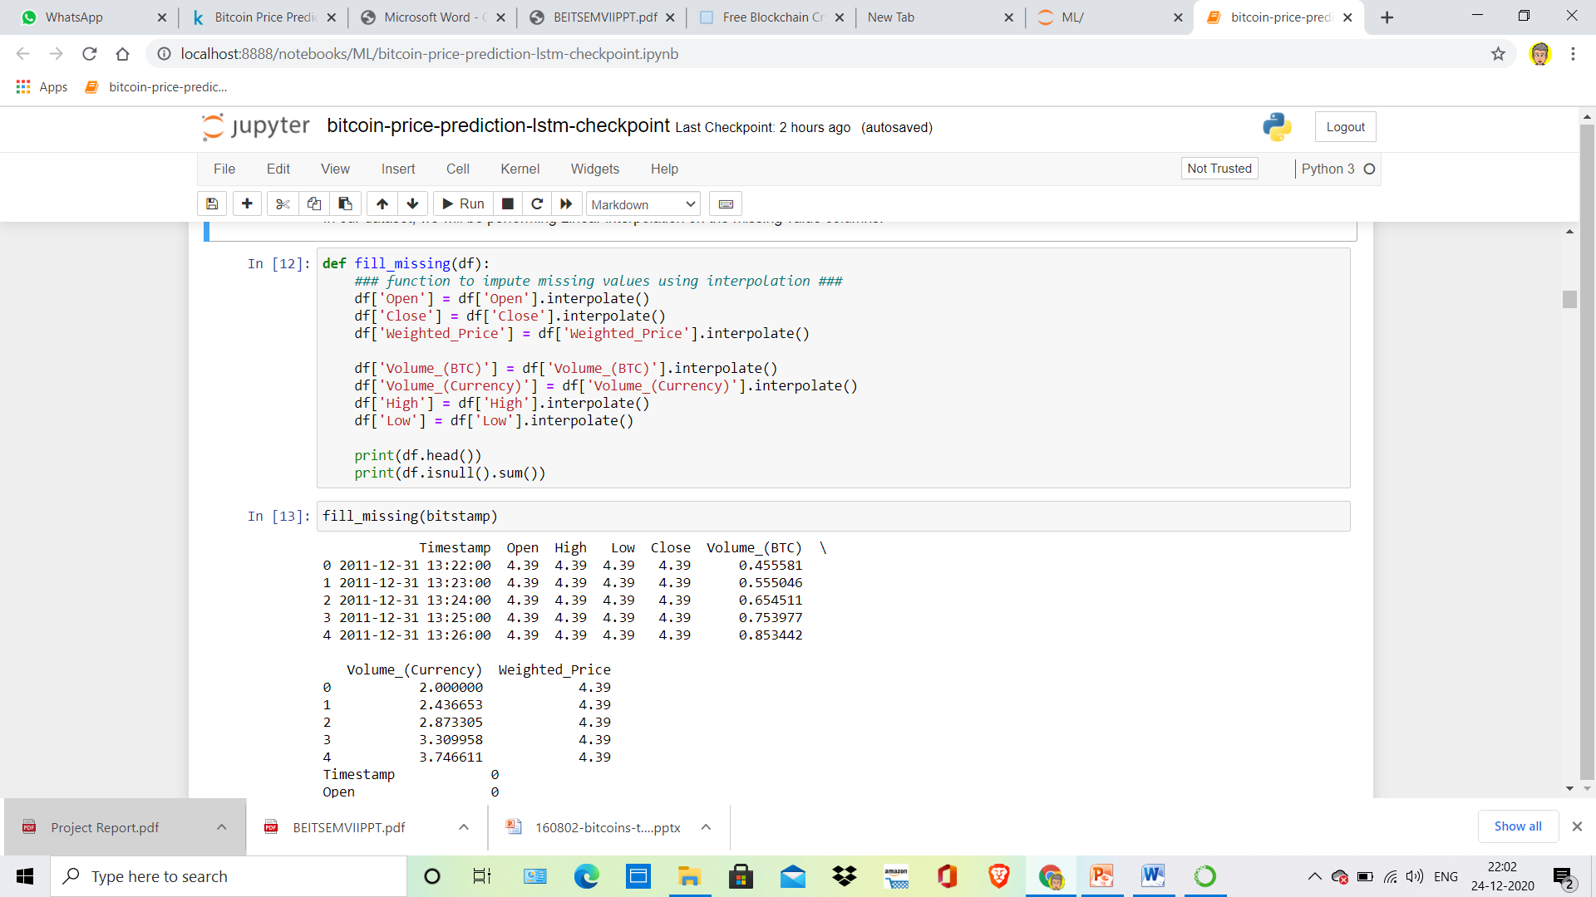
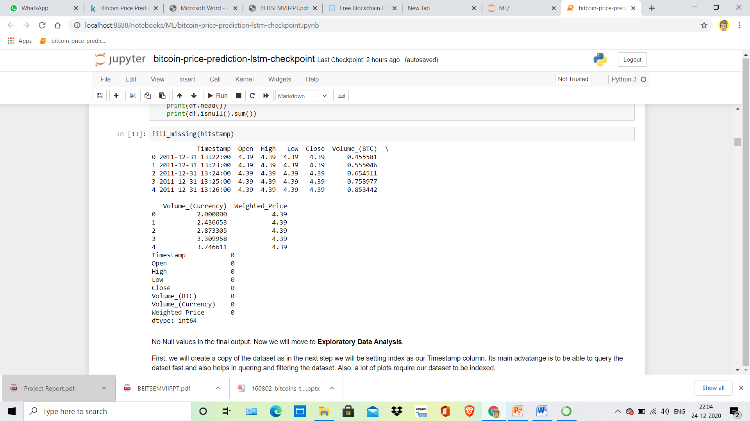
POST-IMPUTATION :

Slide 14
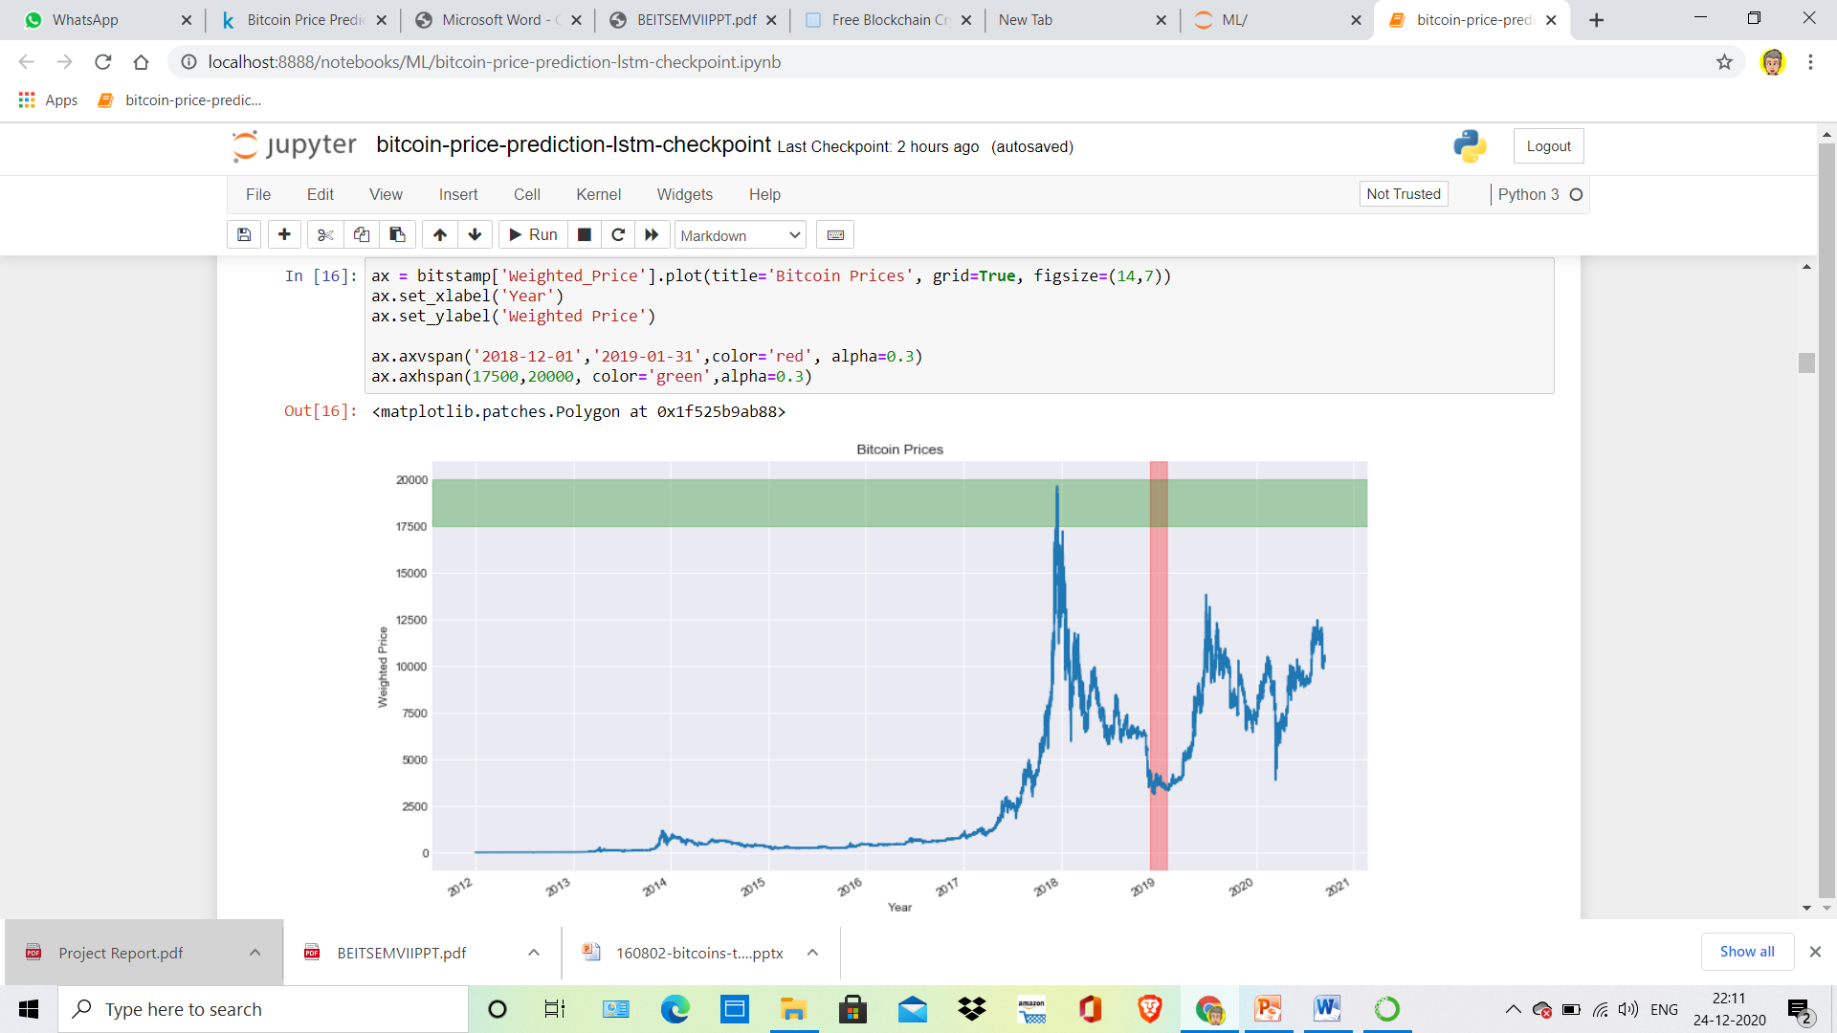
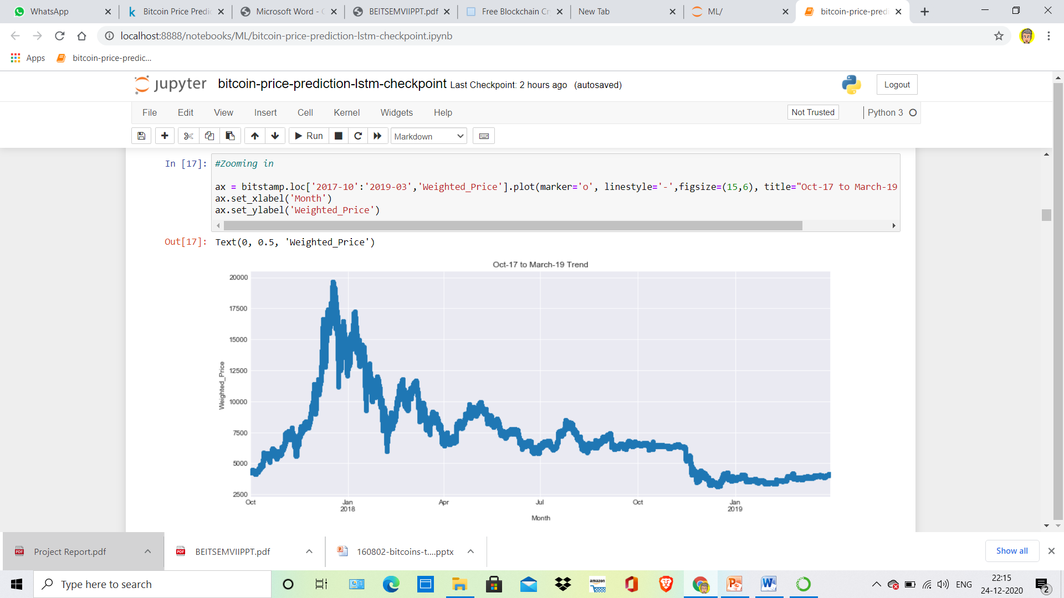
Exploratory Data Analysis
When working with time-series data, a lot can be revealed through visualizing it. It is possible to add markers in the plot to help emphasize the specific observations or specific events in the time series.

Slide 15
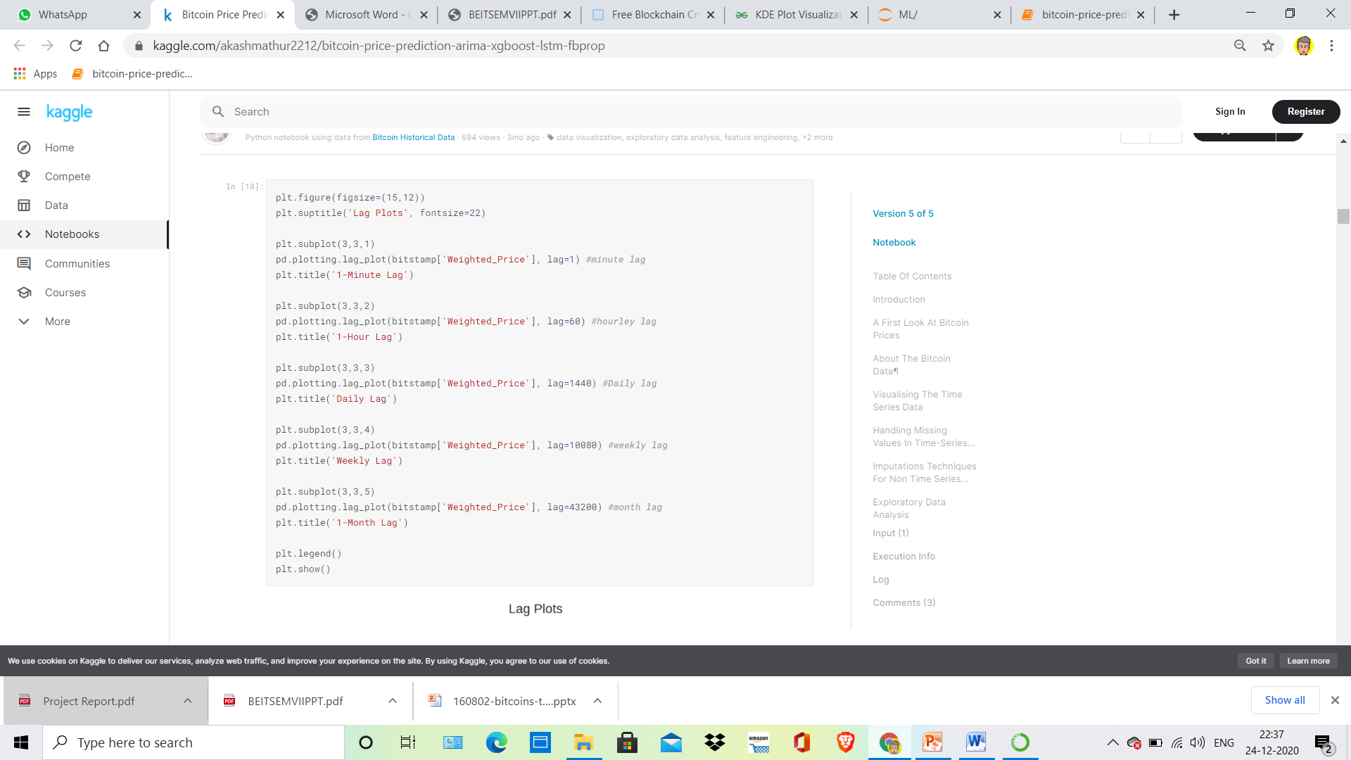
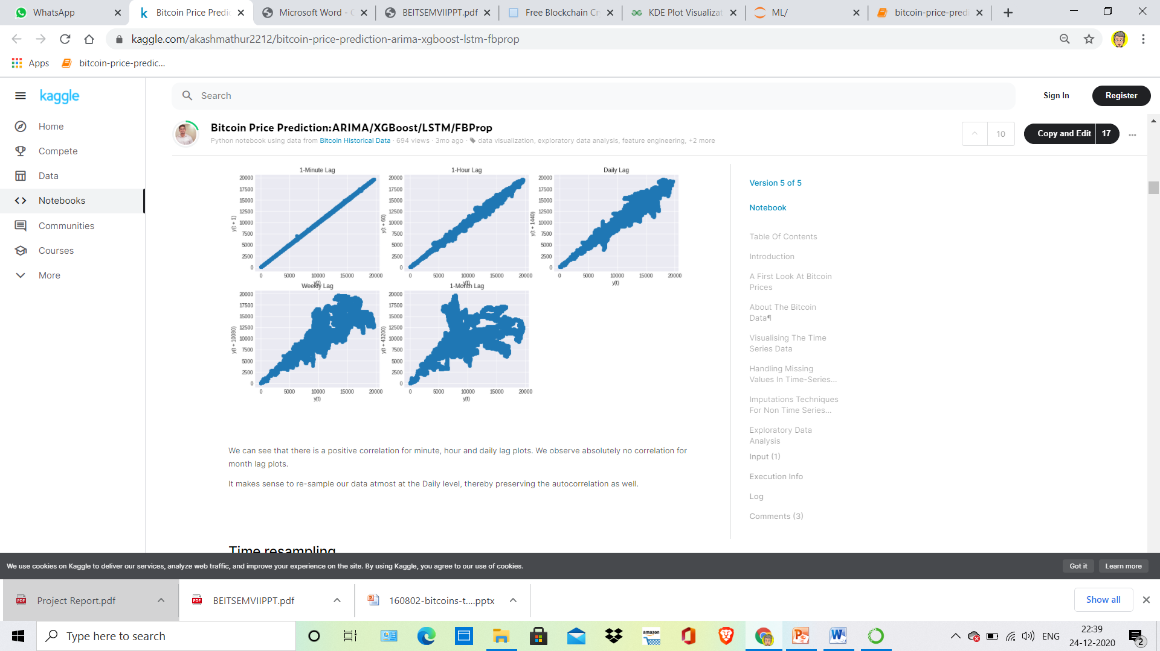
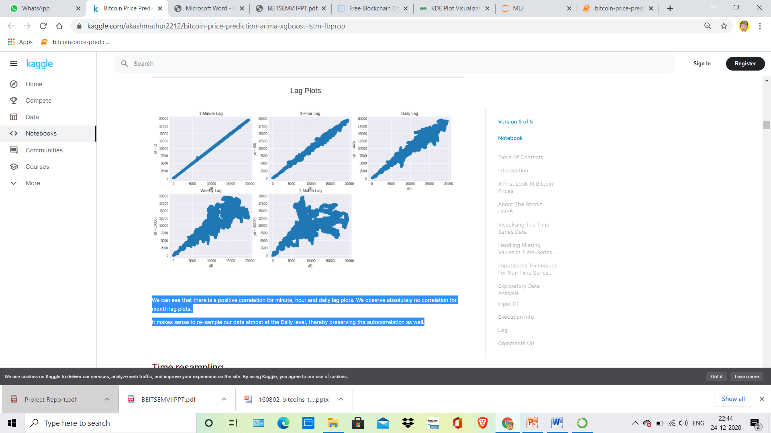
Lag plot are used to observe the autocorrelation. These are crucial when we try to correct the trend and stationarity and we have to use smoothing functions. Lag plot helps us to understand the data better.
Visualizing using Lag Plots
We can see that there is a positive correlation for minute, hour and daily lag plots. We observe absolutely no correlation for month lag plots.
It makes sense to re-sample our data atmost at the Daily level, thereby preserving the autocorrelation as well.

Slide 16
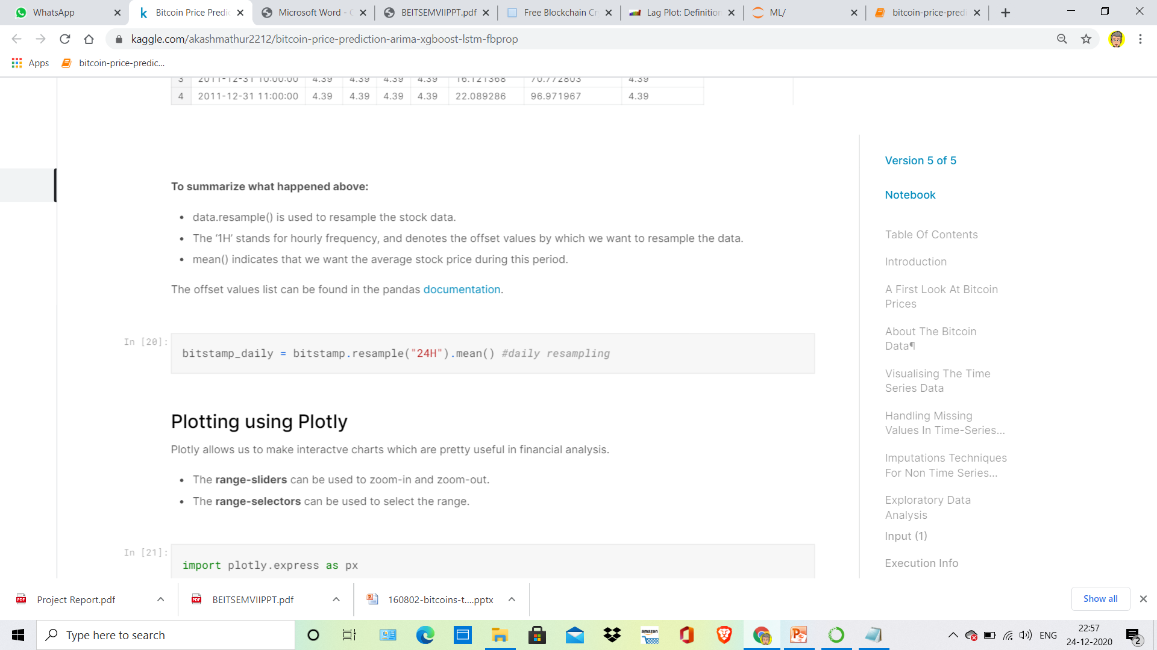
Time resampling
Examining stock price data for every single day isn’t of much use to financial institutions, who are more interested in spotting market trends. To make it easier, we use a process called time resampling to aggregate data into a defined time period, such as by month or by quarter. Institutions can then see an overview of stock prices and make decisions according to these trends.
The pandas library has a .resample() function which resamples such time series data. The resample method in pandas is similar to its groupby method as it is essentially grouping according to a certain time span.
The resample() function looks like this:
To summarize what happened above:
data.resample() is used to resample the stock data.
The ‘24H’ stands for daily frequency, and denotes the offset values by which we want to resample the data.
mean() indicates that we want the average stock price during this period.

Slide 17
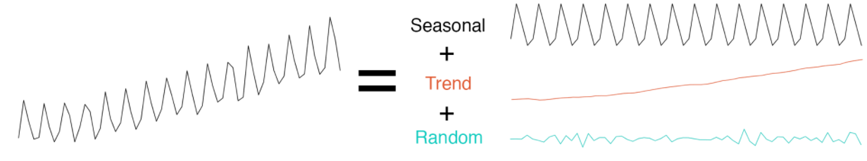
Time Series Decomposition
Time series decomposition involves thinking of a series as a combination of level, trend, seasonality, and noise components. Decomposition provides a useful abstract model for thinking about time series generally and for better understanding problems during time series analysis and forecasting.
Decomposition is often used to remove the seasonal effect from a time series. It provides a cleaner way to understand trends. For instance, lower ice cream sales during winter don’t necessarily mean a company is performing poorly. To know whether or not this is the case, we need to remove the seasonality from the time series.
We can decompose a time series into trend, seasonal and remainder components.
Base model

Slide 18
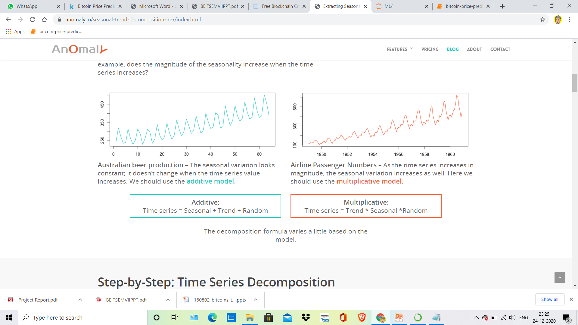
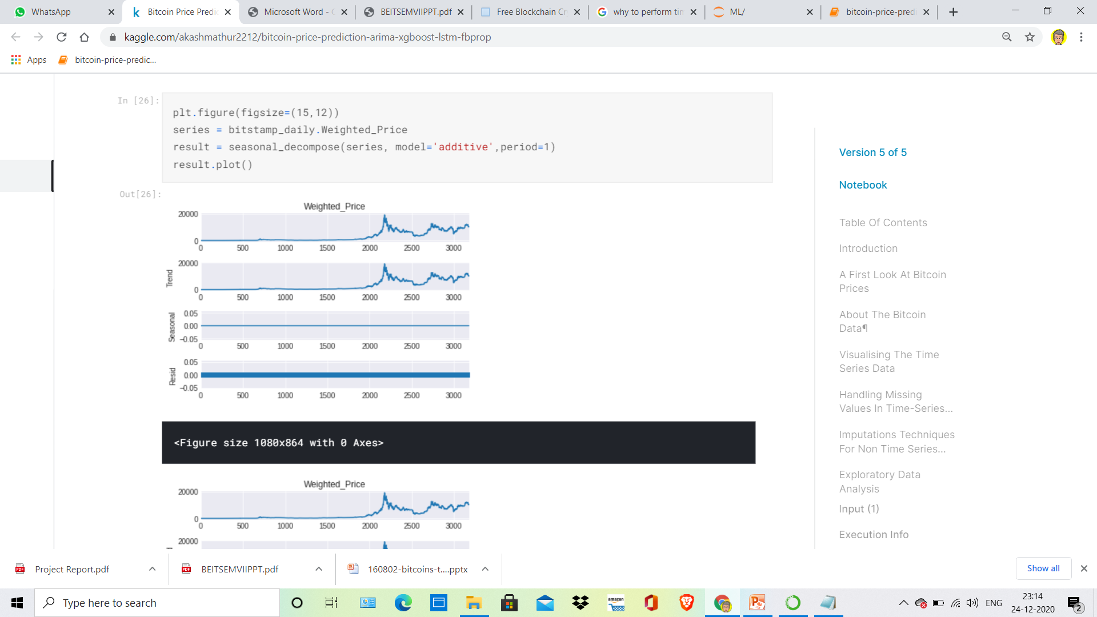
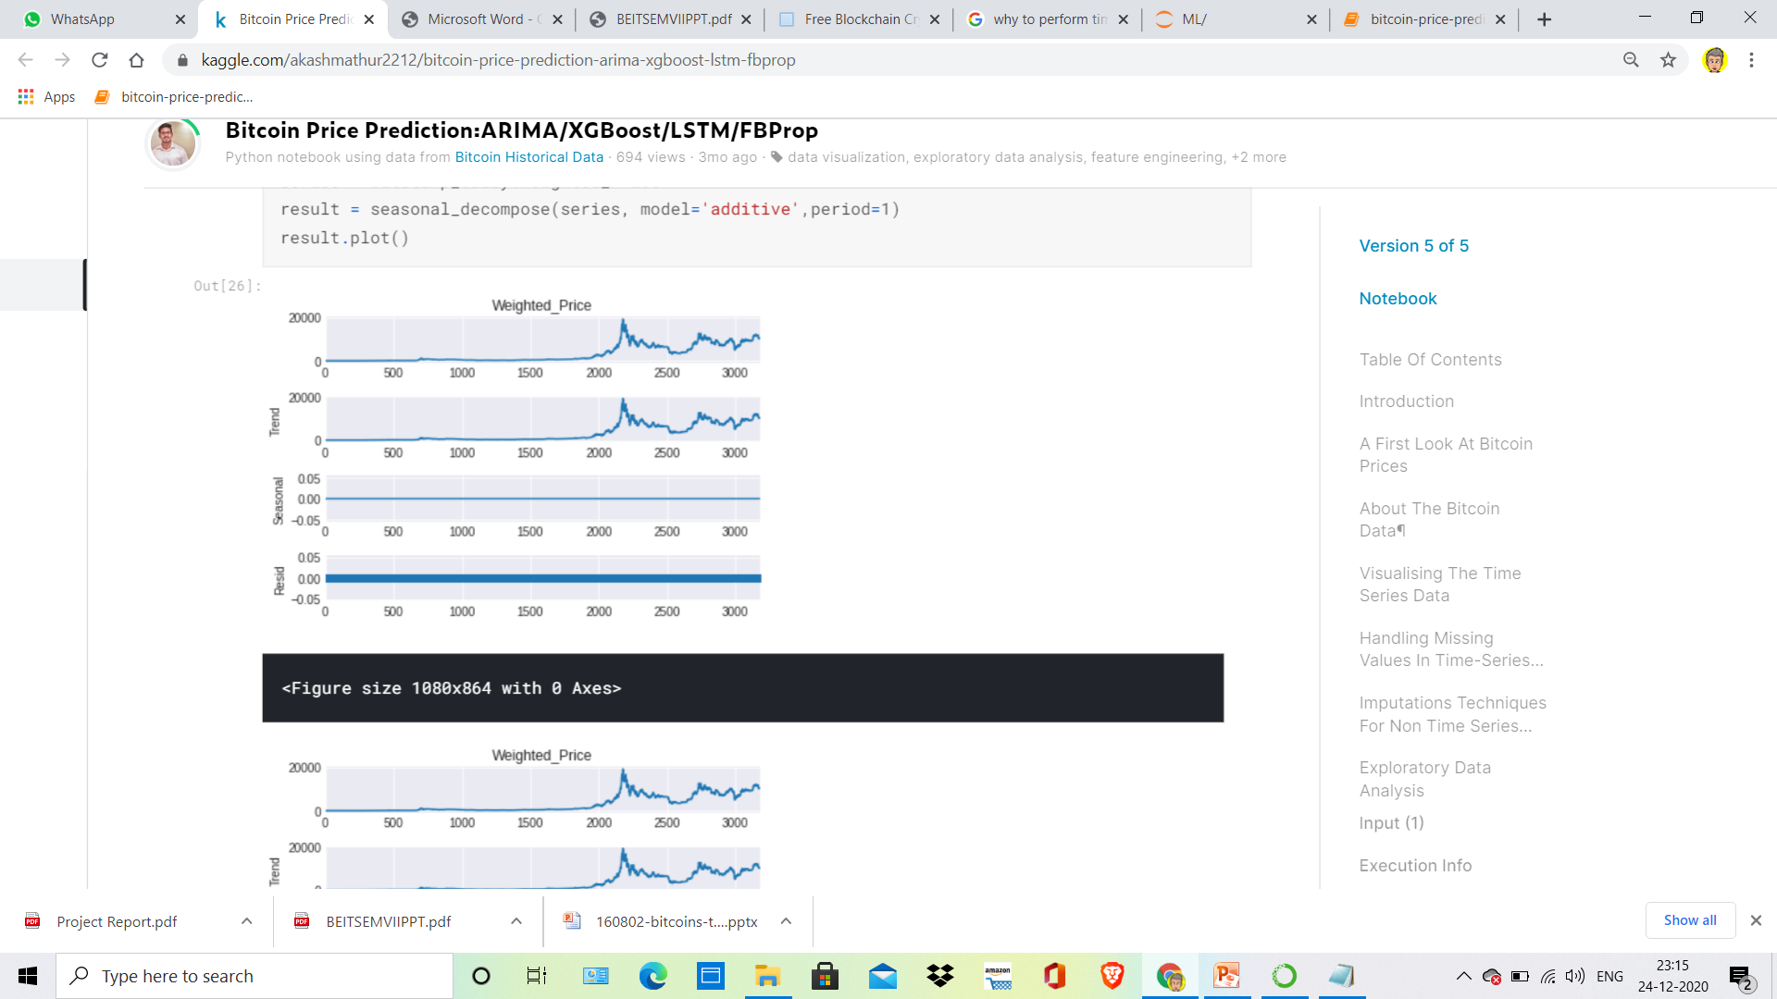
Performing Time Decomposition
Base model
Model after Seasonal Decomposition
Post time series decomposition we don't observe any seasonality. Also, there is no constant mean, variance and covariance, hence the series is Non Stationary.

Slide 19
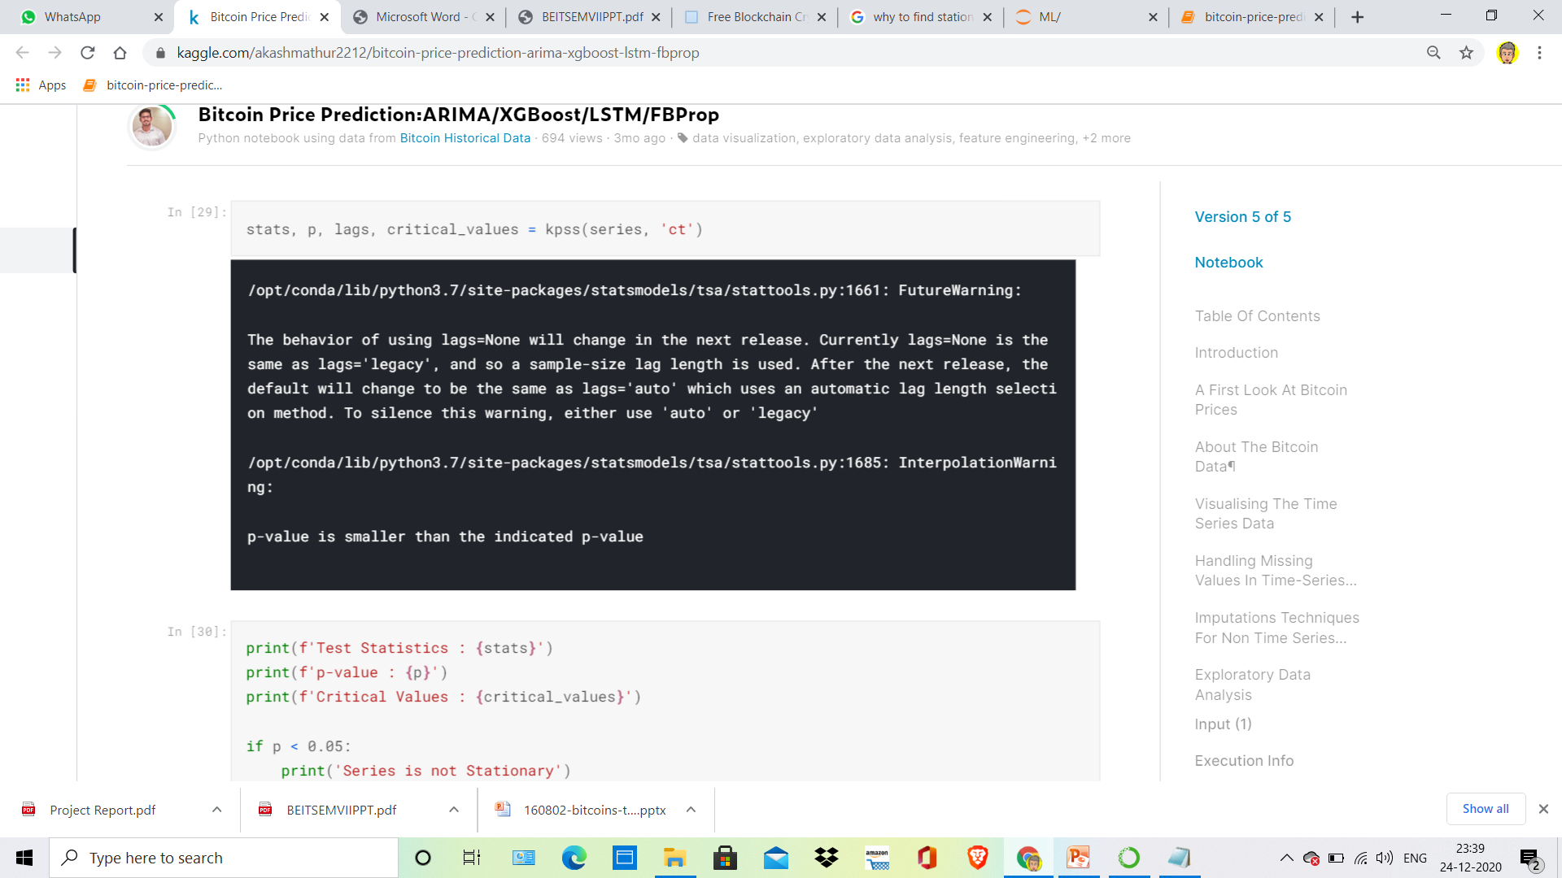
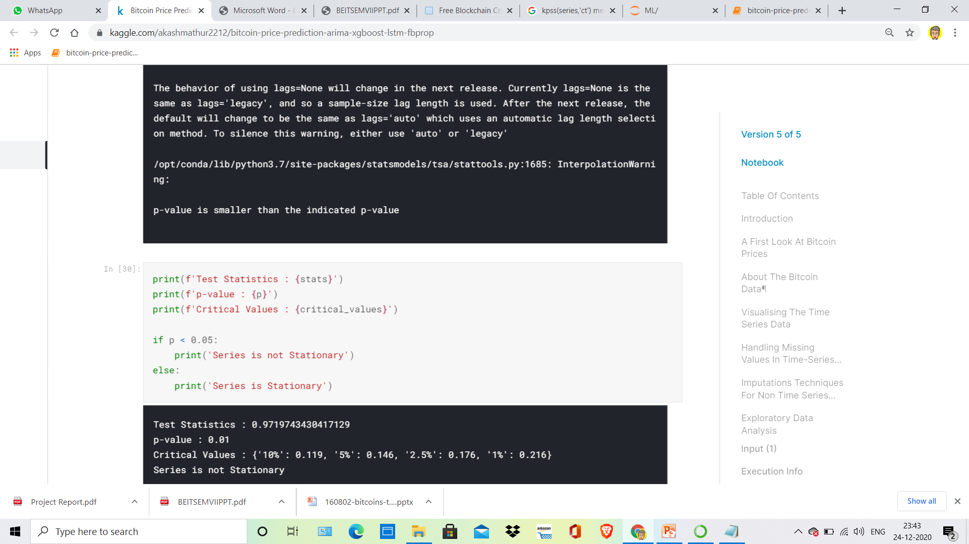
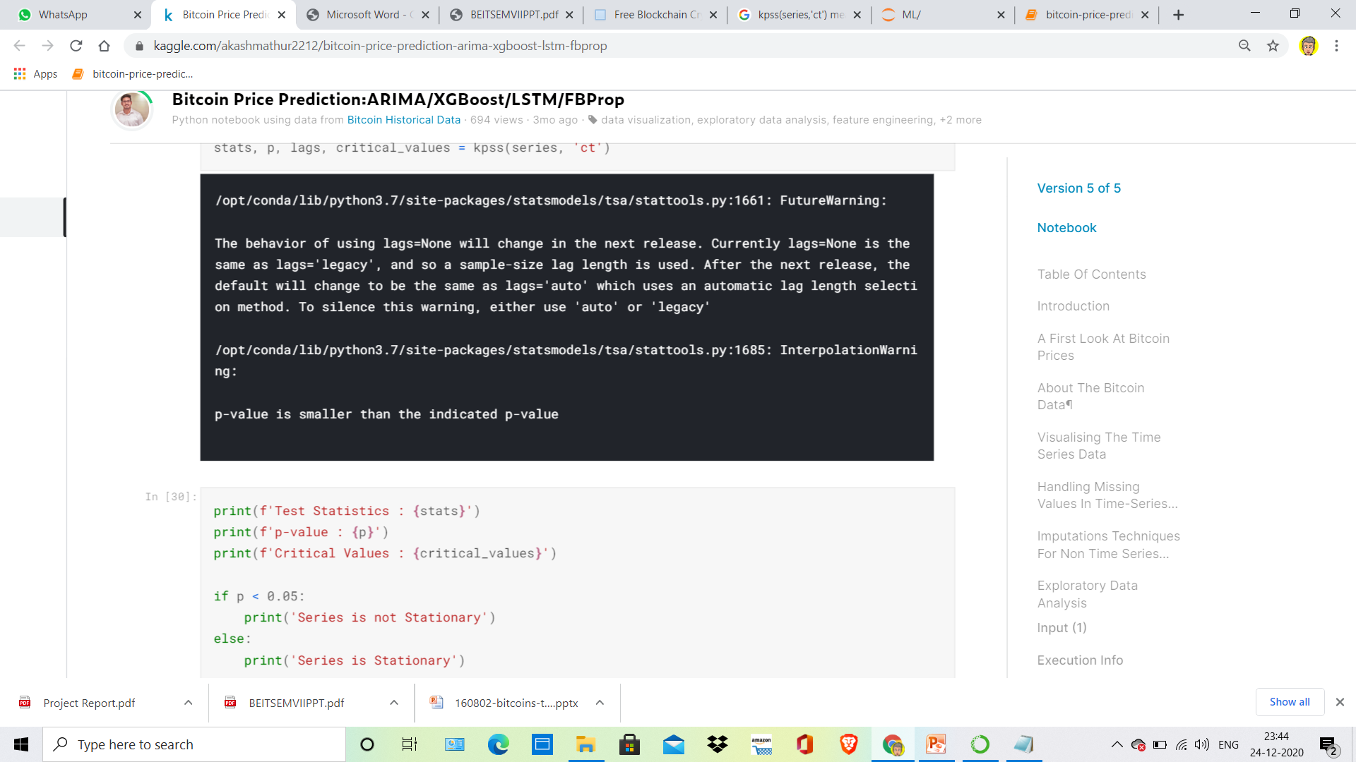
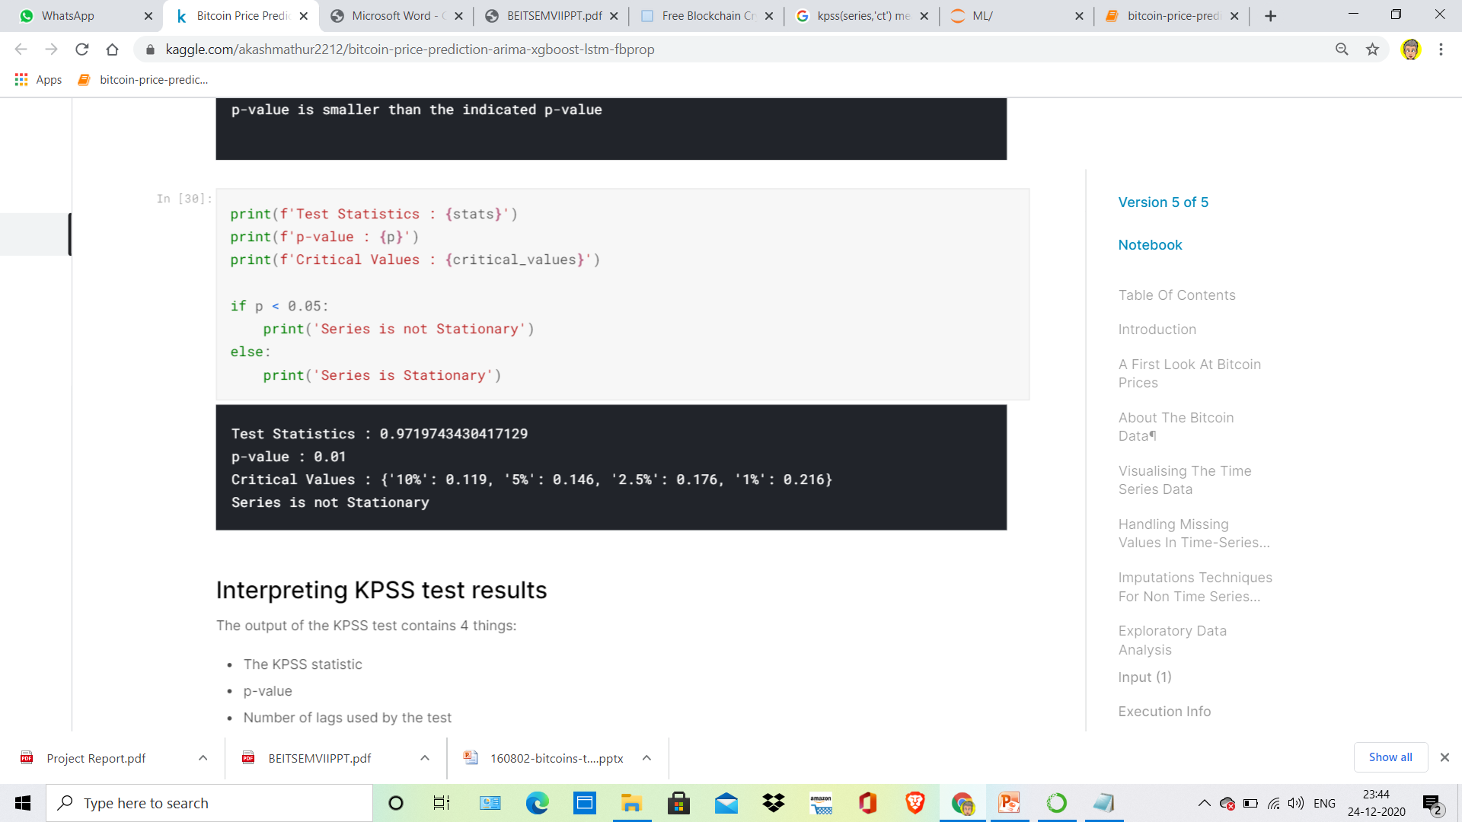
Stationarity is an important concept in time series analysis as it means that the statistical properties of a a time series do not change over time.
We will perform statistical tests like KPSS and ADF to confirm our understanding.
KPSS Test
The KPSS test, short for, Kwiatkowski-Phillips-Schmidt-Shin (KPSS), is a type of Unit root test that tests for the stationarity of a given series around a deterministic trend.
Here, the null hypothesis is that the series is stationary.
That is, if p-value is < signif level (say 0.05), then the series is non-stationary and vice versa
‘ct’ : The data is stationary around a trend.

Slide 20
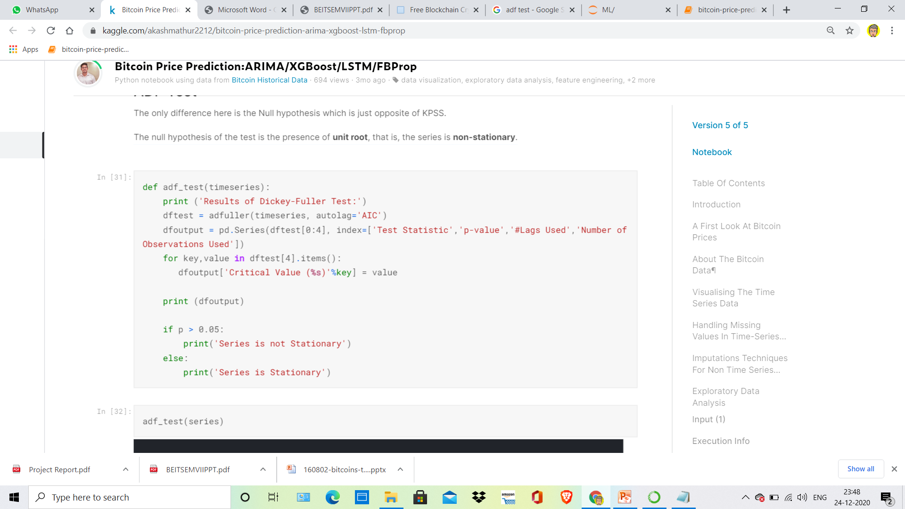
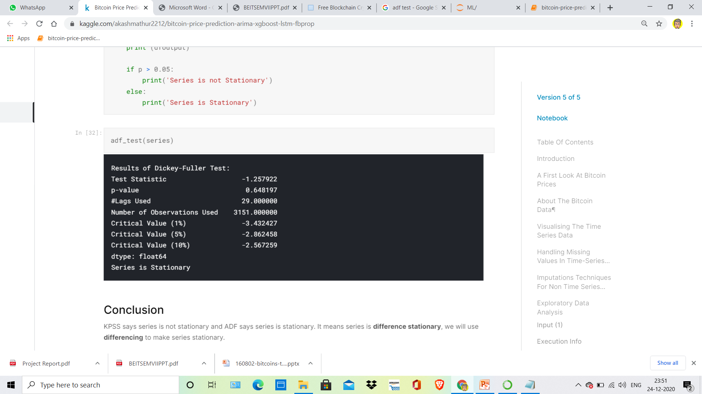
ADF Test
The null hypothesis of the test is the presence of unit root, that is, the series is non-stationary.
KPSS says series is not stationary and ADF says series is stationary. It means series is difference stationary, we will use differencing to make series stationary.

Slide 21
Model Building
As for Model Selection We studied some research papers based on time-series data prediction and we encountered some models namely ARIMA,XGBOOST,LSTM etc.
On the basis of research papers as well as comparing the models accuracy we made a decision of using LSTM to build our model due to high performance and accuracy than other models while dealing with time-series data

Slide 22
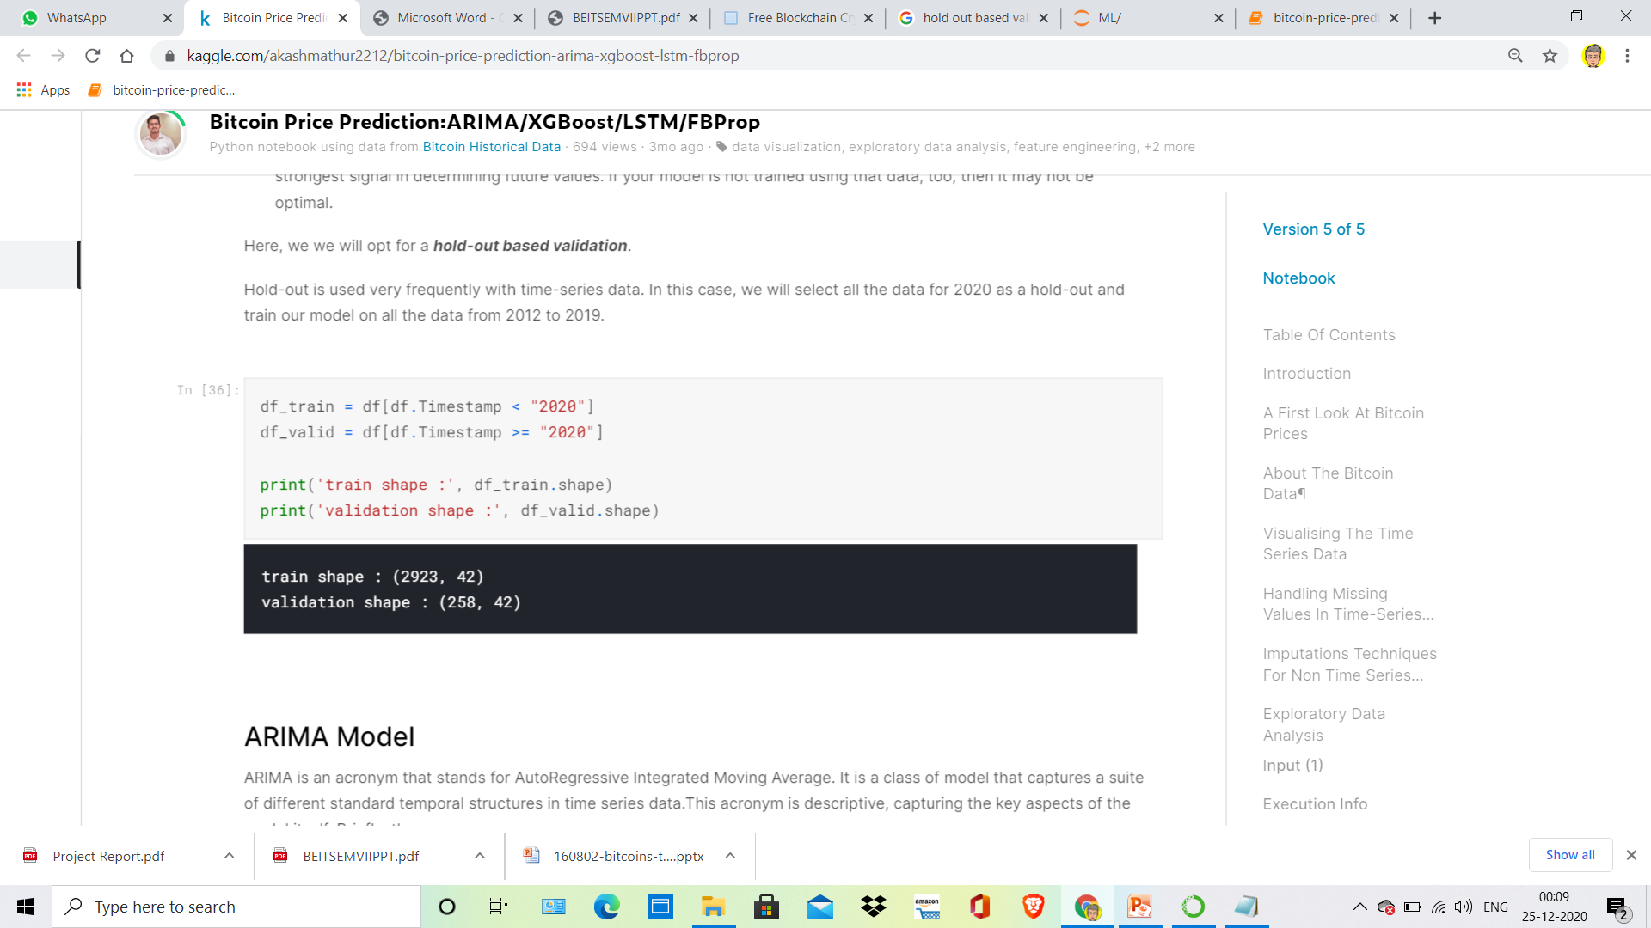
Before Model Building one important step is CROSS-VALIDATION.
To measure the performance of our forecasting model, We typically want to split the time series into a training period and a validation period. This is called fixed partitioning
If the time series has some seasonality, you generally want to ensure that each period contains a whole number of seasons. For example, one year, or two years, or three years, if the time series has a yearly seasonality. You generally don't want one year and a half, or else some months will be represented more than others.
we will opt for a hold-out based validation.
Hold-out is used very frequently with time-series data. In this case, we will select all the data for 2020 as a hold-out and train our model on all the data from 2012 to 2019.

Slide 23
Long Short Term Memory (LSTM) Networks
Long Short Term Memory networks – usually just called “LSTMs” – are a special kind of RNN, capable of learning long-term dependencies.
LSTMs are explicitly designed to avoid the long-term dependency problem. Remembering information for long periods of time is practically their default behavior, not something they struggle to learn like RNNs!
All recurrent neural networks have the form of a chain of repeating modules of neural network. In standard RNNs, this repeating module will have a very simple structure, such as a single tanh layer.
Also, they don't suffer from problems like vanishing/exploding gradient descent.

Slide 24
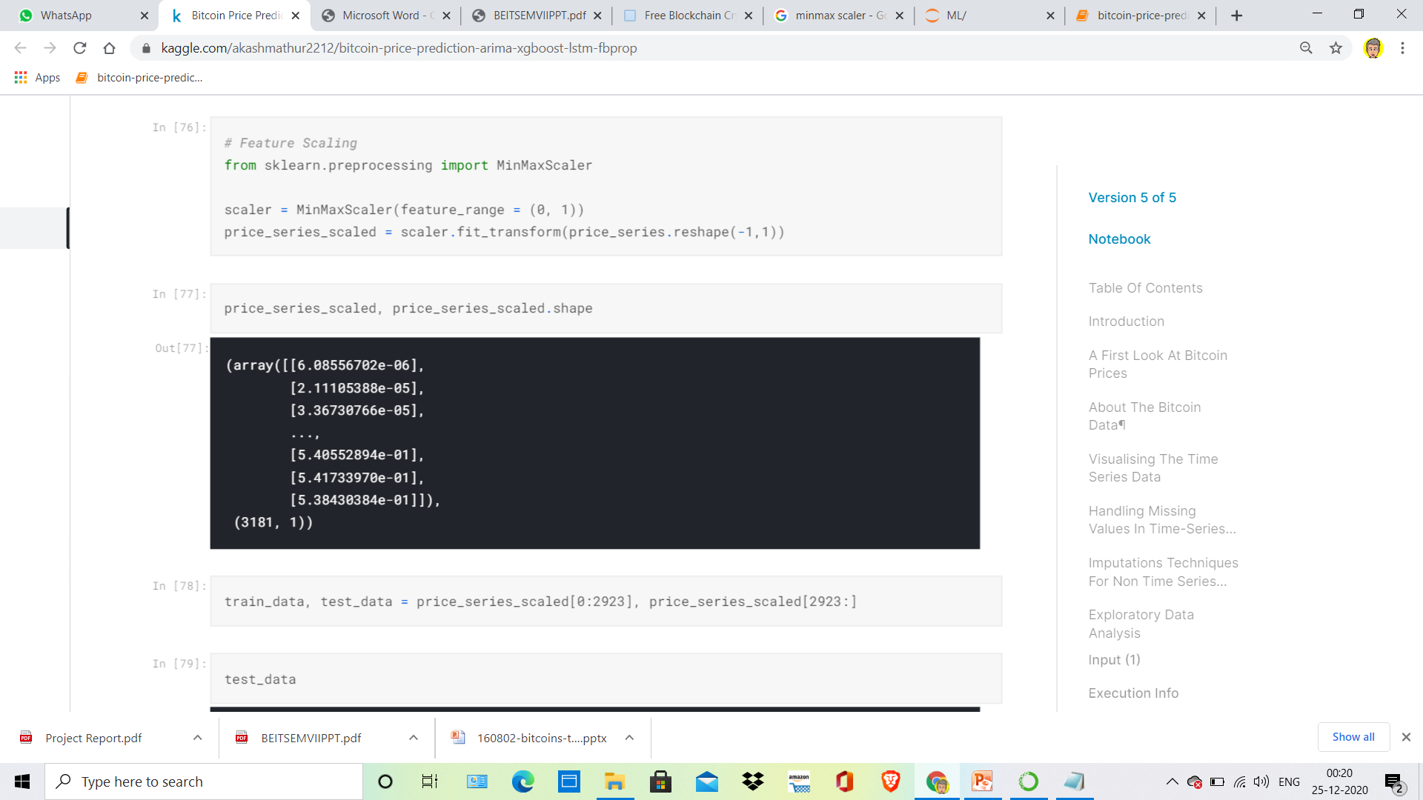
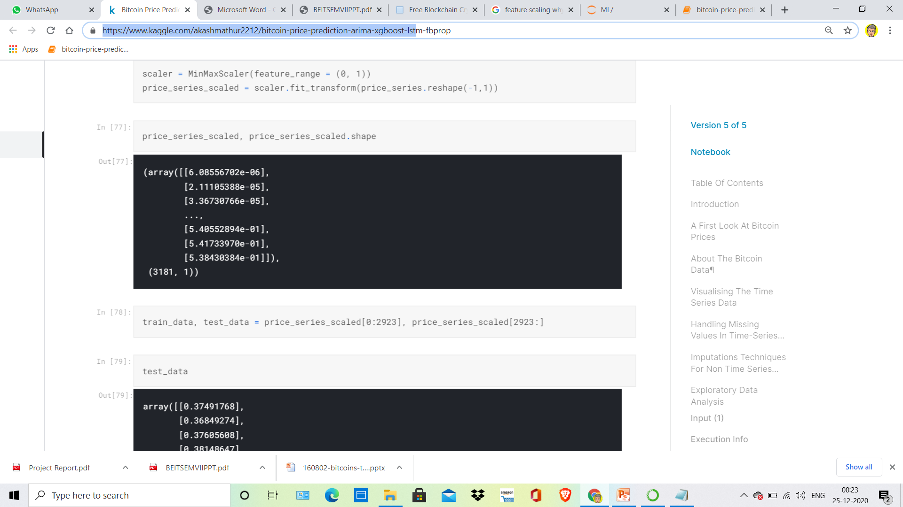
Feature Scaling or Standardization: It is a step of Data Pre Processing which is applied to independent variables or features of data. It basically helps to normalise the data within a particular range. Sometimes, it also helps in speeding up the calculations in an algorithm.

Slide 25
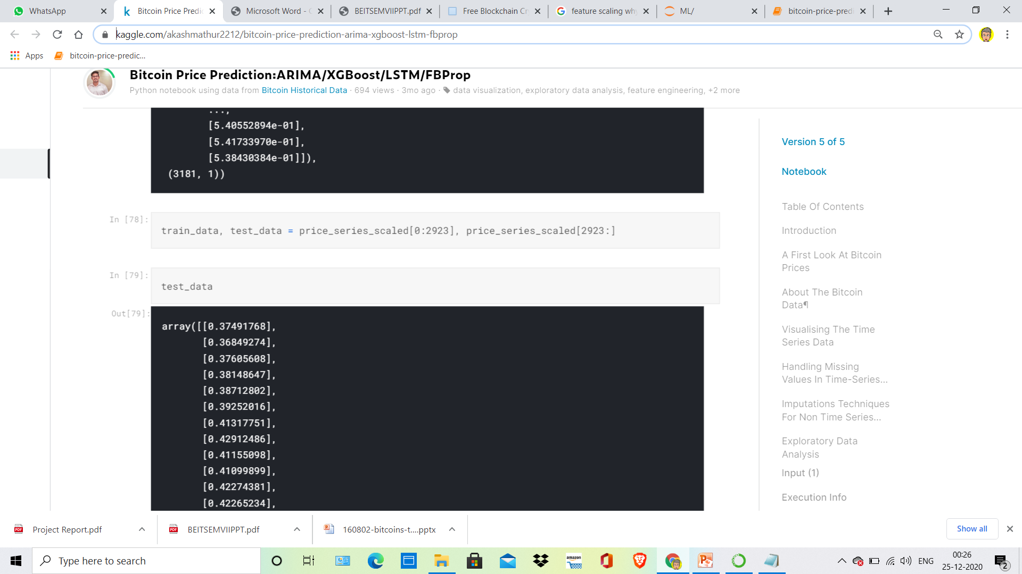
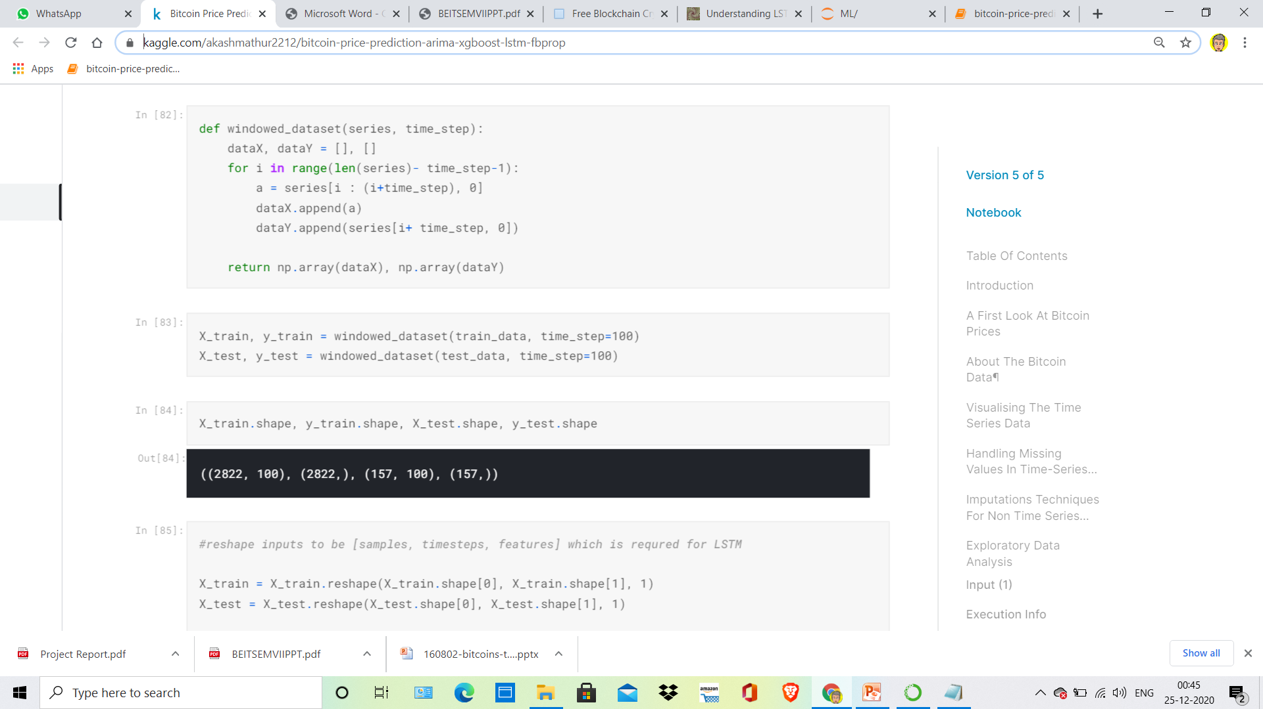
We Split the dataset into train_data and test_data:
Then we are splitting our dataset into a window of particular Time-step:

Slide 26
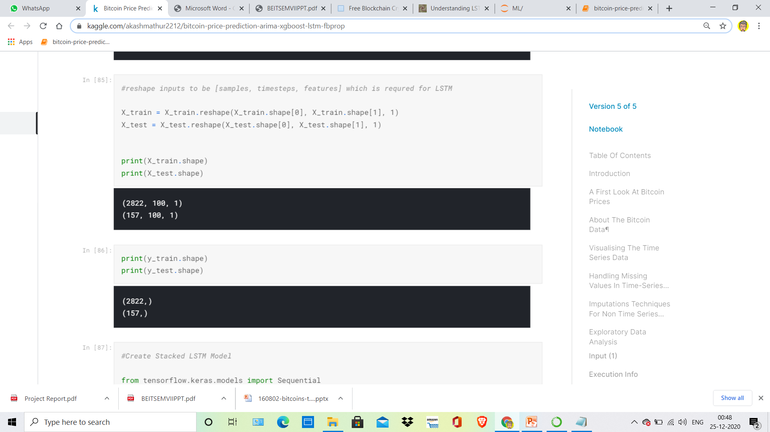
Now Reshaping our inputs as LSTM takes input with timesteps and features and here our Feature value is 1 i.e our values lies between 0 & 1

Slide 27
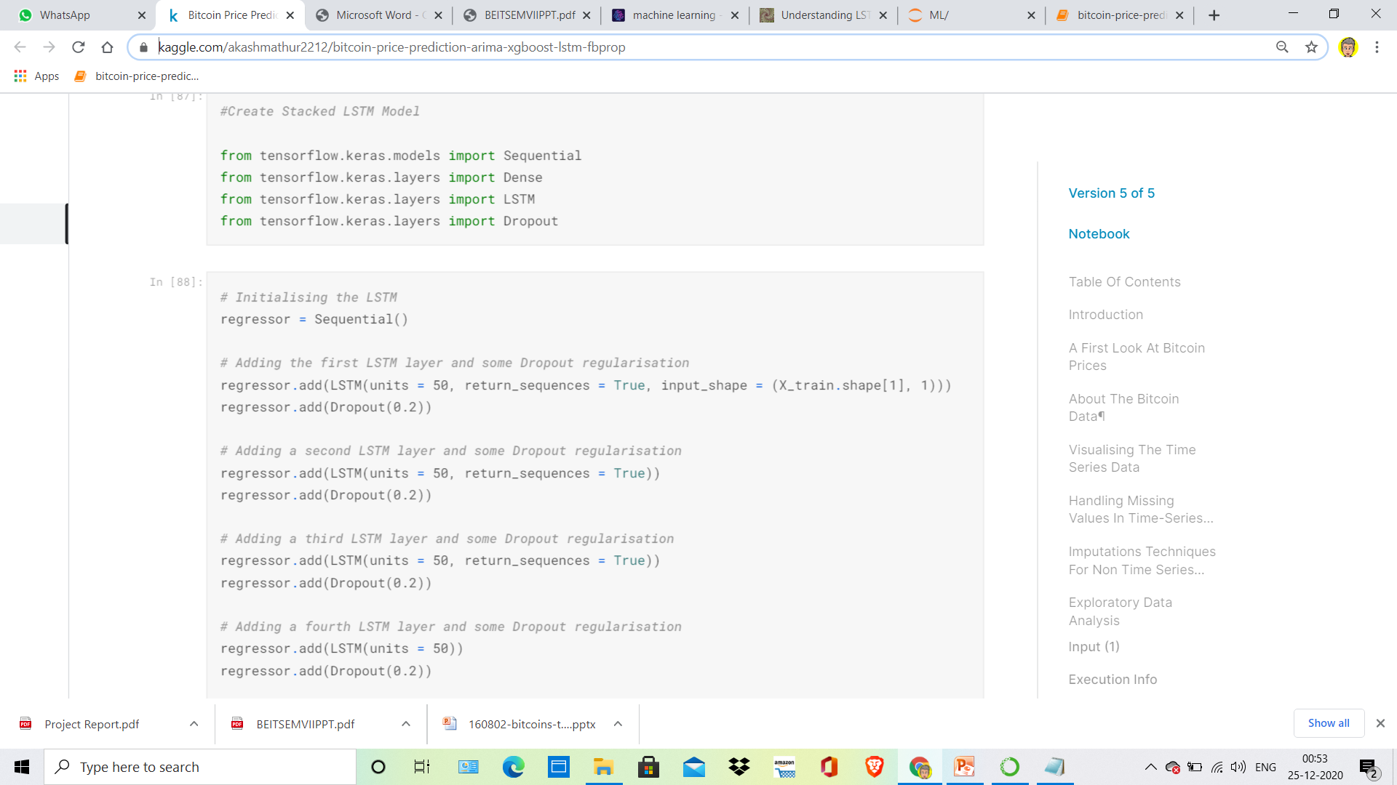
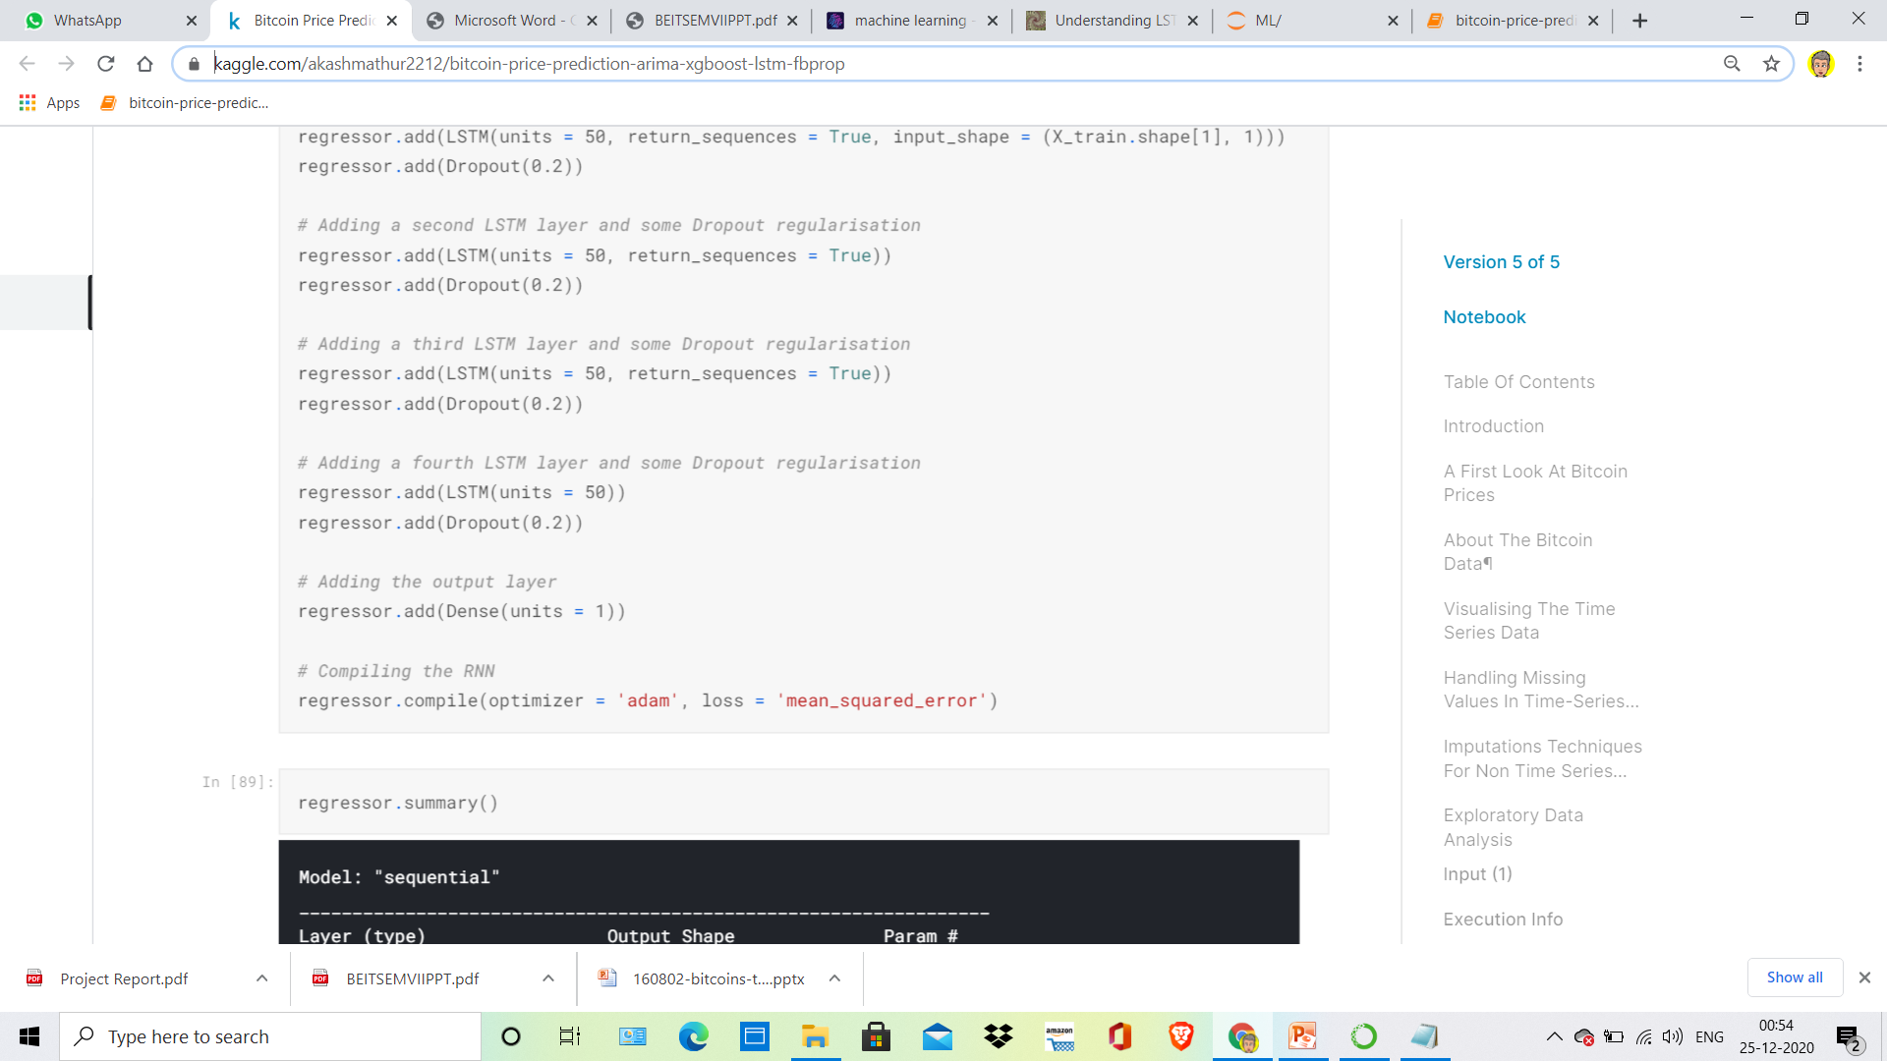

Slide 28
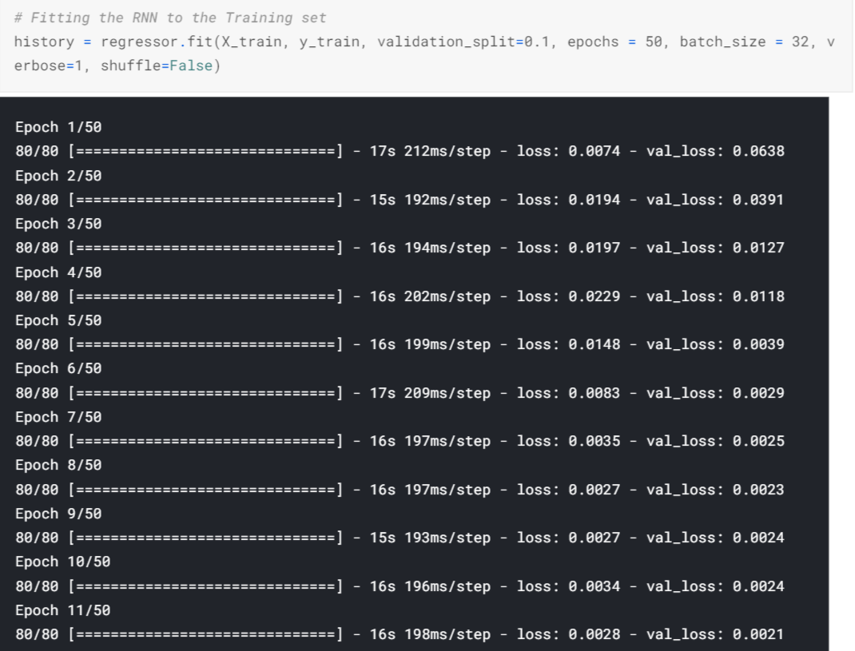

Slide 29
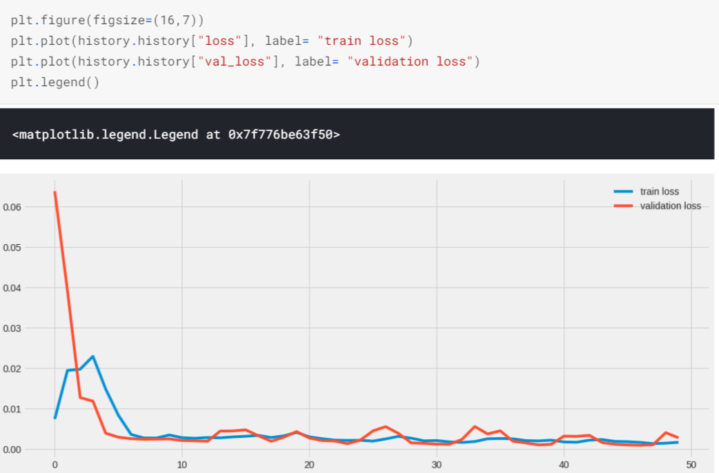
Through Training and Validation loss we can see that the model is not overfitting i.e its pretty good for Prediction.

Slide 30
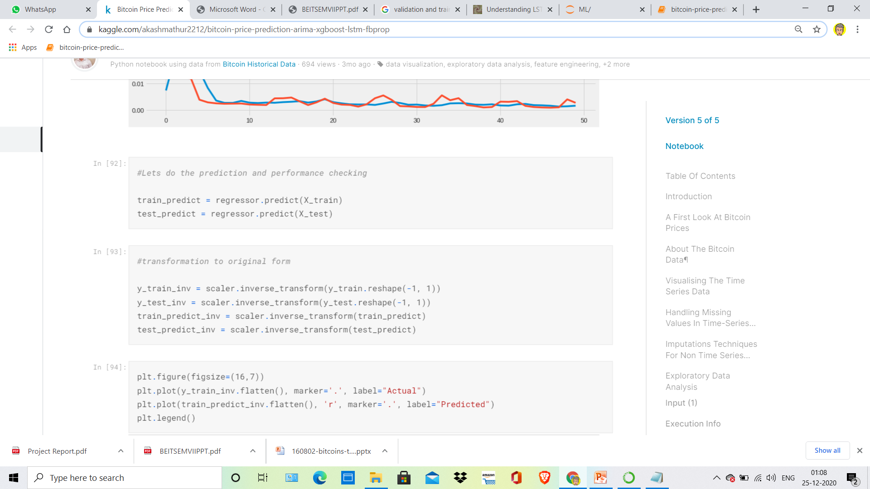
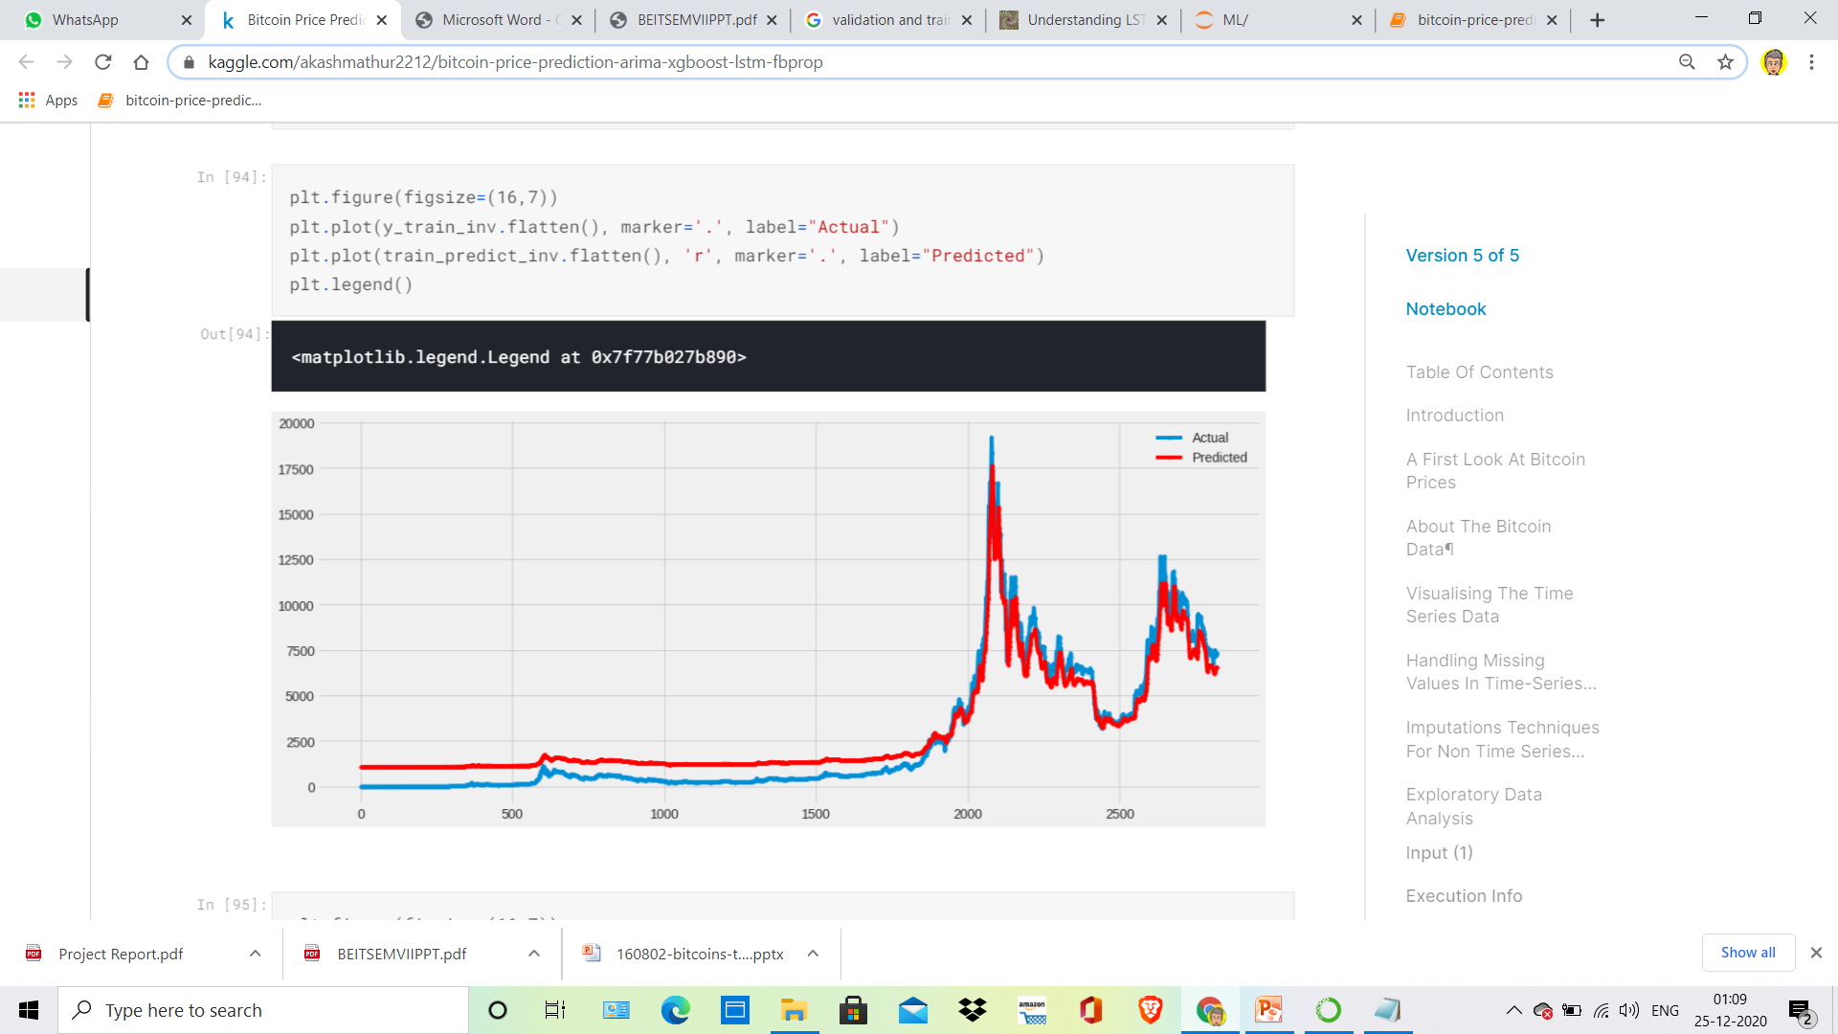

Slide 31
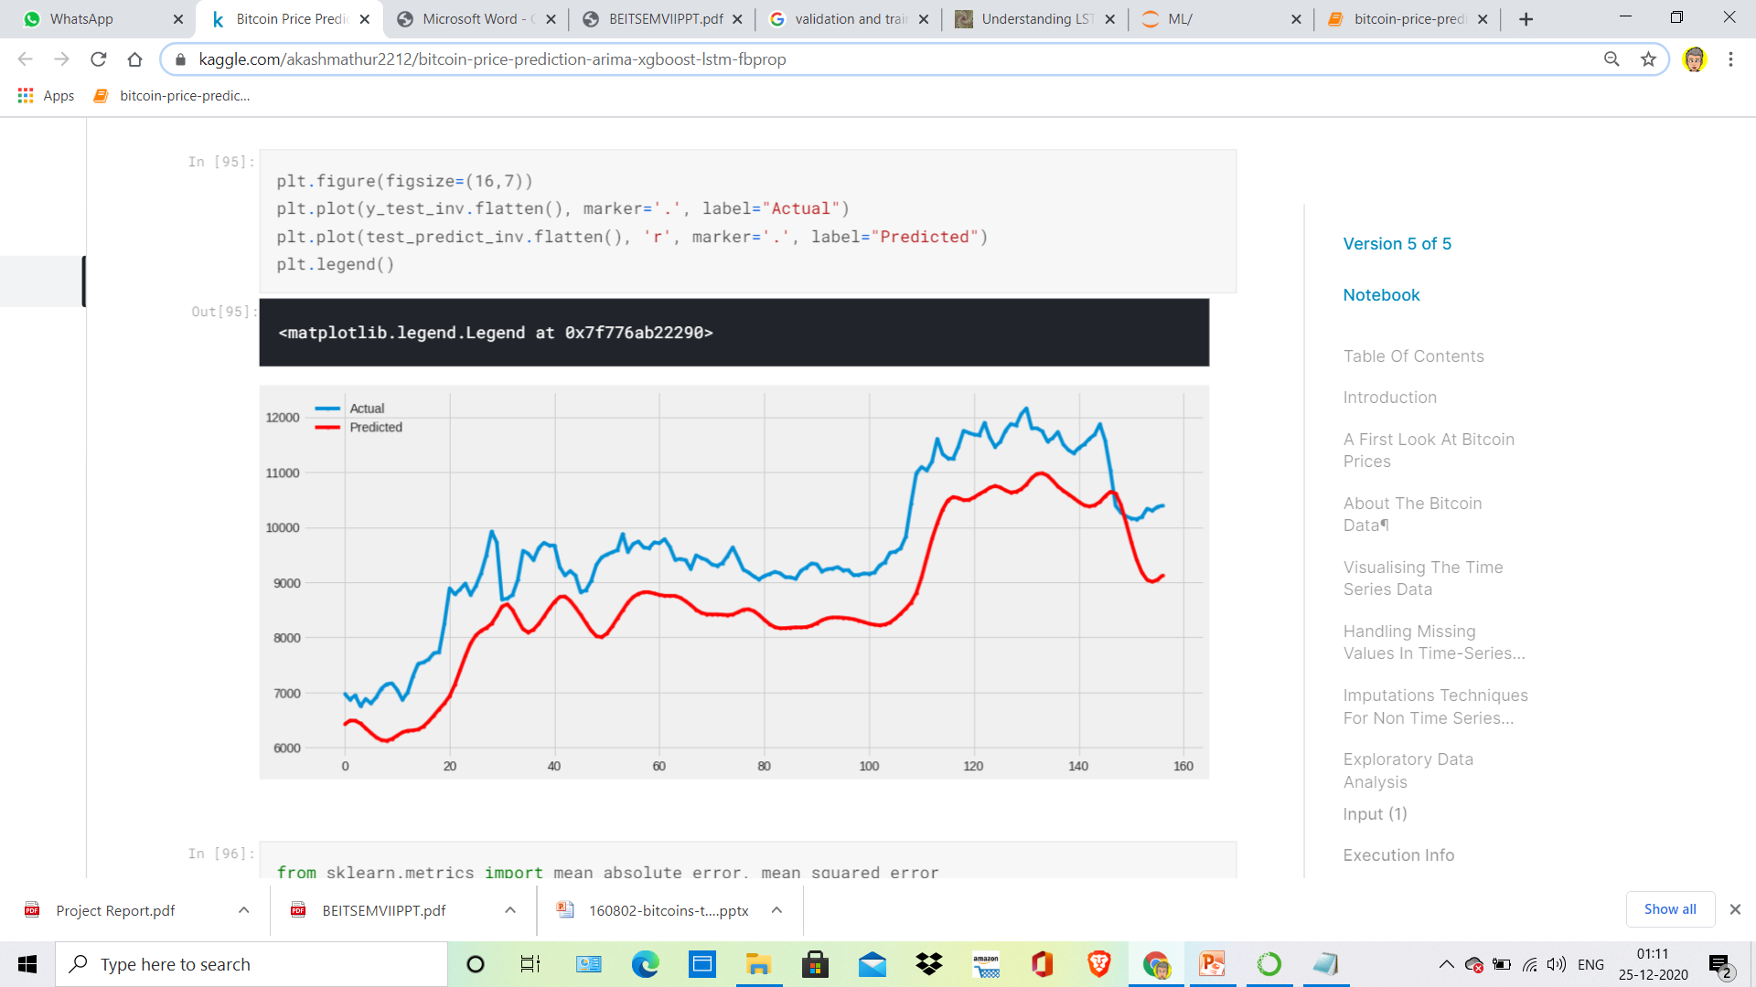

Slide 32
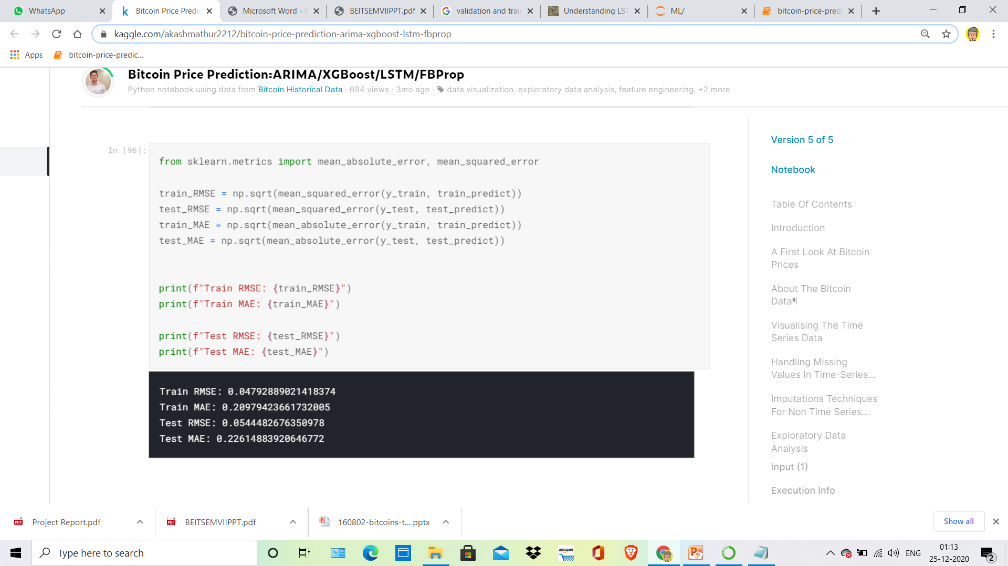

Slide 33
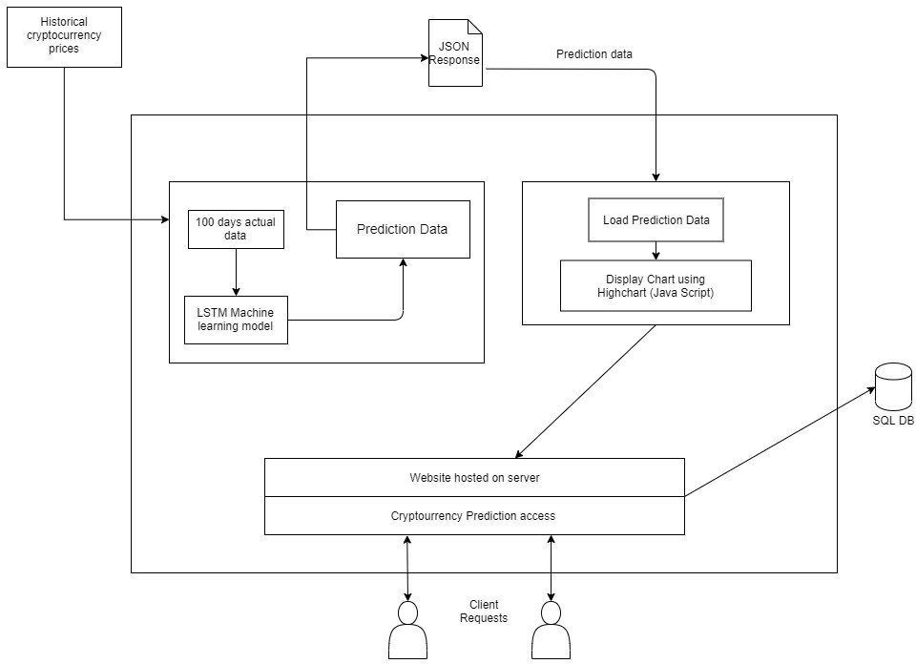
System Architecture

Slide 34
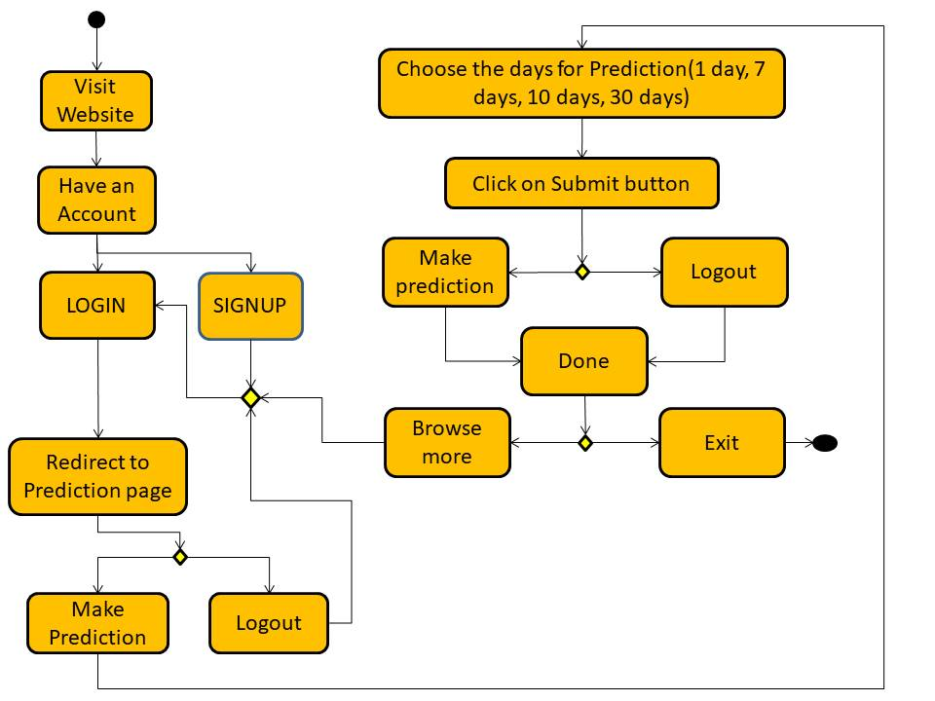
Activity Diagram

Slide 35
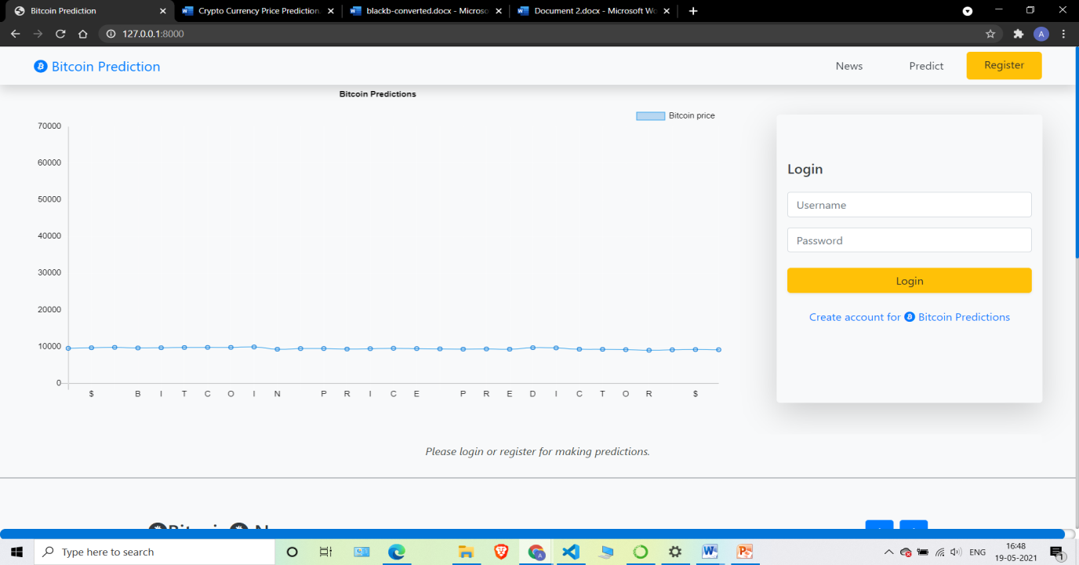
User Interface(Landing page)

Slide 36

Signup page

Slide 37
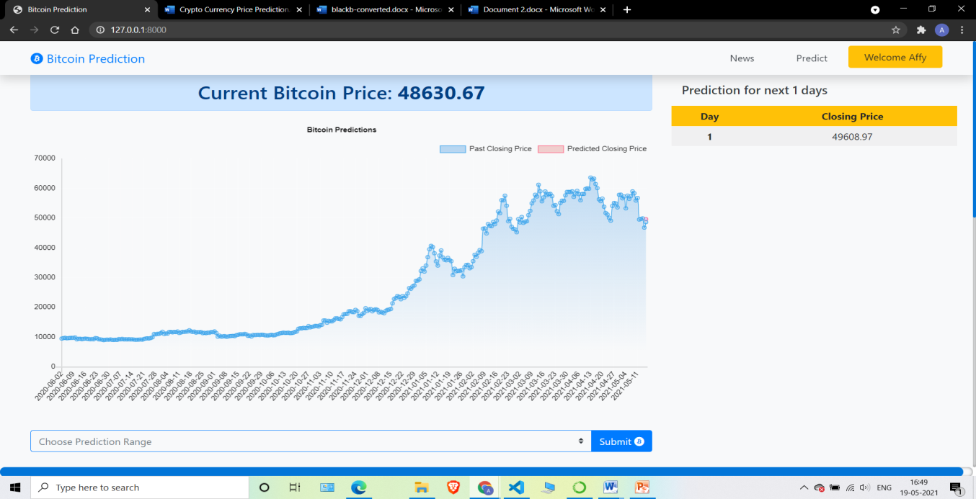
Prediction Section

Slide 38
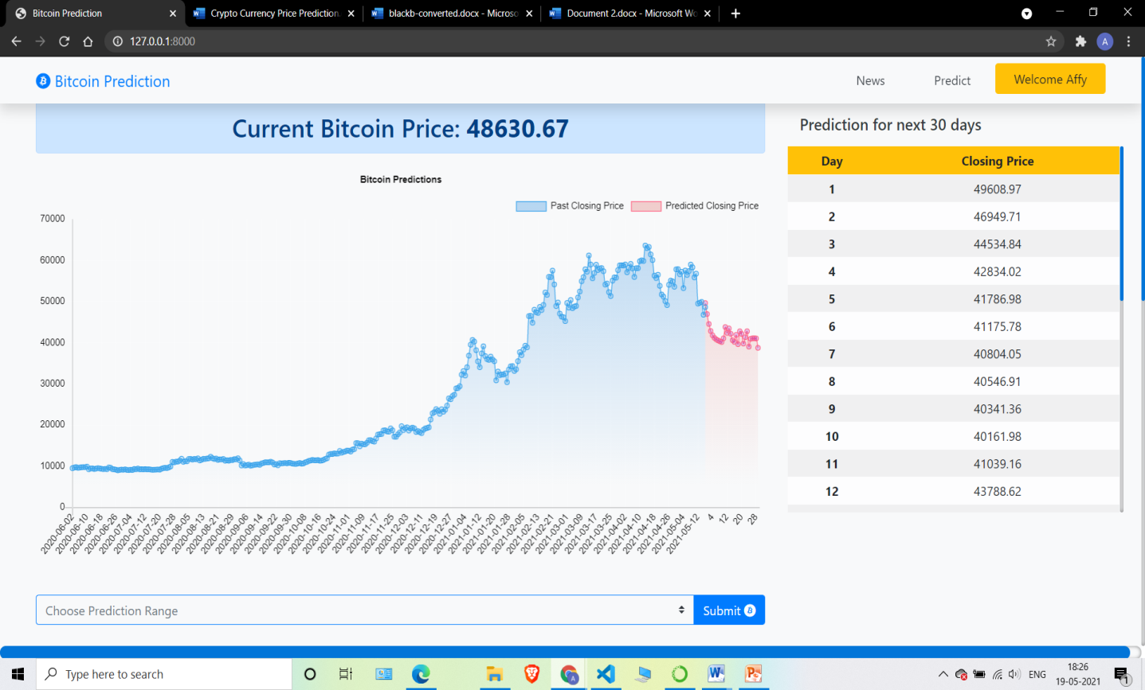
Prediction Result

Slide 39
Conclusion
Our Proposed model has been succeeded to provide the result prediction bitcoin from Historical bitcoin dataset. Our model with time series techniques can build produce the results and the results can predict the price for the next 30 days with split the data to train and test that we mention above. Afterward, as we mentioned before in the article, the Crypto Currency market is influenced by many uncertainty factors. The Cryptocurrencies are influenced by many uncertainties factor such as political issue, the economic issue at impacted to local or global levels. So prediction price bitcoin using LSTM can’t good enough to make the decision to invest in bitcoin, it is another side for taking the decisions.

Slide 40
Future Scope
Wider varieties of cryptocurrencies: Of course, it
would be ideal to have all the major cryptocurrencies such as Ethereum, Litecoin, Ripple and the recently developed Bitcoin Cash implemented in and being predicted by this application.
Open an account with us:
As of now Bitcoin Predictor web application only acts as an informative website and user can only create an account to predict Bitcoin price. We are planning to expand this so that the user can open his Demat and other account to sell or purchase cryptocurrencies.

Slide 41
References
[1] https://www.researchgate.net/publication/340567768_Bitcoin_Price_Predi ction_using_ARIMA_Model
[2] https://www.researchgate.net/publication/307598782_Resampling_Strateg ies_for_Imbalanced_Time_Series
[3] https://en.wikipedia.org/wiki/Long_short-term_memory
[4]https://www.researchgate.net/publication/271978892_Comparison_of_Lin ear_Interpolation_Method_and_Mean_Method_to_Replace_the_Missing_Val ues_in_Environmental_Data_Set
[5]https://www.researchgate.net/publication/313867740_A_review_of_missin g_values_handling_methods_on_time-series_data
[6]https://www.researchgate.net/publication/336061476_A_Comparative_Stu dy_of_Bitcoin_Price_Prediction_Using_Deep_Learning
[7] http://colah.github.io/posts/2015-08-Understanding-LSTMs/

